Slide 1

CEIS 106 INTRO TO OPERATERING SYSTEMS final project
By: Taylor muse
Professor nazila safavi
Devry university

Slide 2
introduction
In this PowerPoint I will demonstrate my proficiency in performing Linux SYSADMIN duties
Throughout this course I learned how to use the linux system
I learned how to create users both through terminal commands and through the GUI
I learned how to delete profiles through terminal commands and the GUI
I created new directories, files and gave permissions for users, root, and groups
I used shell scripts to schedule tasks to be performed and redirected outputs of commands to secondary files
I configured network information for connectivity to the internet and confirmed different IP addresses
I viewed system activity and started and stopped processes from the terminal window

Slide 3
Course Project
Operating Systems
Module 2 Linux Filesystem Hierarchy

Slide 4
Navigate the Linux filesystem tree
1. What is the pwd command an acronym for? What about the cd command?
Answer here: print working directory
2. Explain the differences between a relative path and an absolute/full path in Linux.
Answer here: Relative path is the path from the current directory you are in and will not have a / before the directory name. absolute path is the path starting from root and starts with / to indicate it starts from root
References:
1. Eckert, J. W. (2019). Linux+ and LPIC-1 Guide to Linux Certification (5th ed.). Cengage.
2. Eckert, J. W. (2019). Linux+ and LPIC-1 Guide to Linux Certification (5th ed.). Cengage.

Slide 5
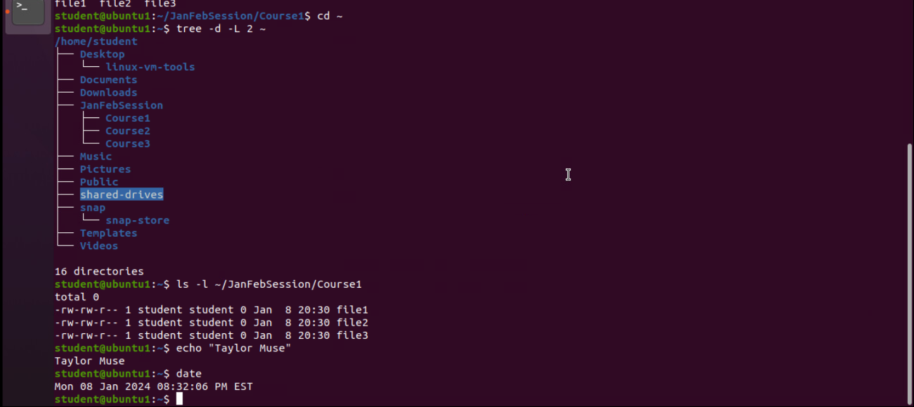
Create directories and files
Take a screenshot of the output in Steps 5 and 6.

Slide 6
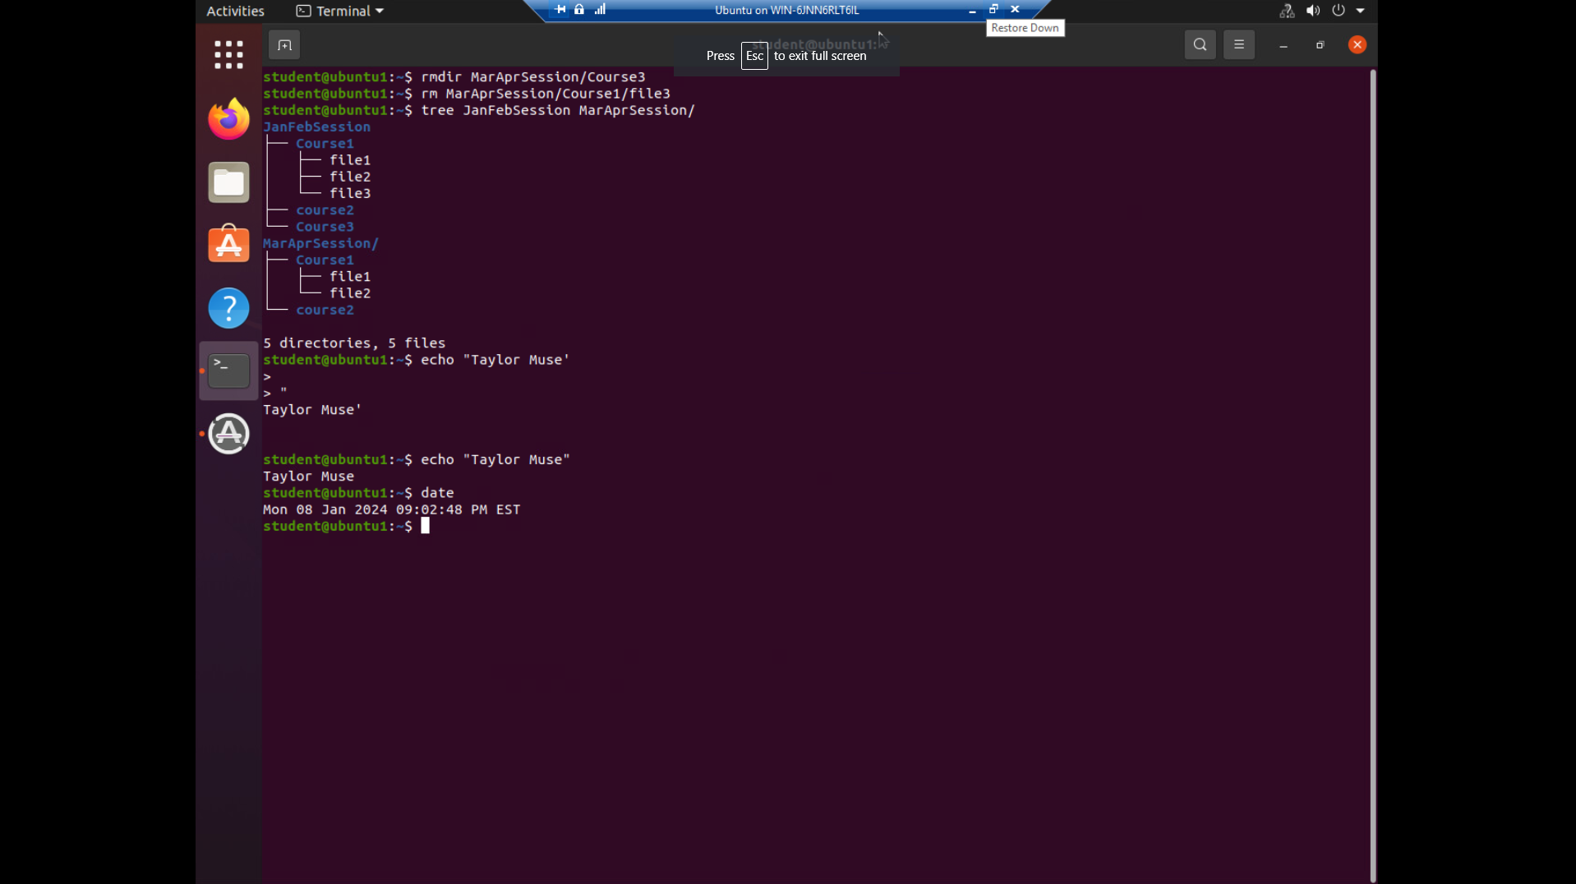
Copy and remove directories and files

Slide 7
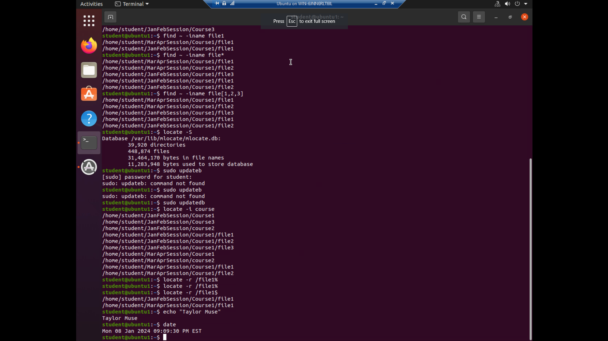
Locate directories and files

Slide 8
Module 2 summary
Located file path
Created a new directory
Created files located within the directory
Copied the files to another directory, deleted file 3 from the course 1 maraprsession directory and course 3 directory
Searched for the files to verify they could be found based on the author of the files

Slide 9
Course Project
Operating Systems
Module 3 Linux Shell Scripts

Slide 10
Create a shell script
1. What are the file permissions of the script?
Answer here: -rw-rw-r--
2. What’s the name of the user-defined variable in the script?
Answer here: $text
3. Which redirection meta-character is used in the script? What does it do?
Answer here:>> appends the file with the command prior to the metacharacter which added the date and adds lists specified by the user to the file
References:
1. Eckert, J. W. (2019). Linux+ and LPIC-1 Guide to Linux Certification (5th ed.). Cengage.
2. Eckert, J. W. (2019). Linux+ and LPIC-1 Guide to Linux Certification (5th ed.). Cengage.

Slide 11
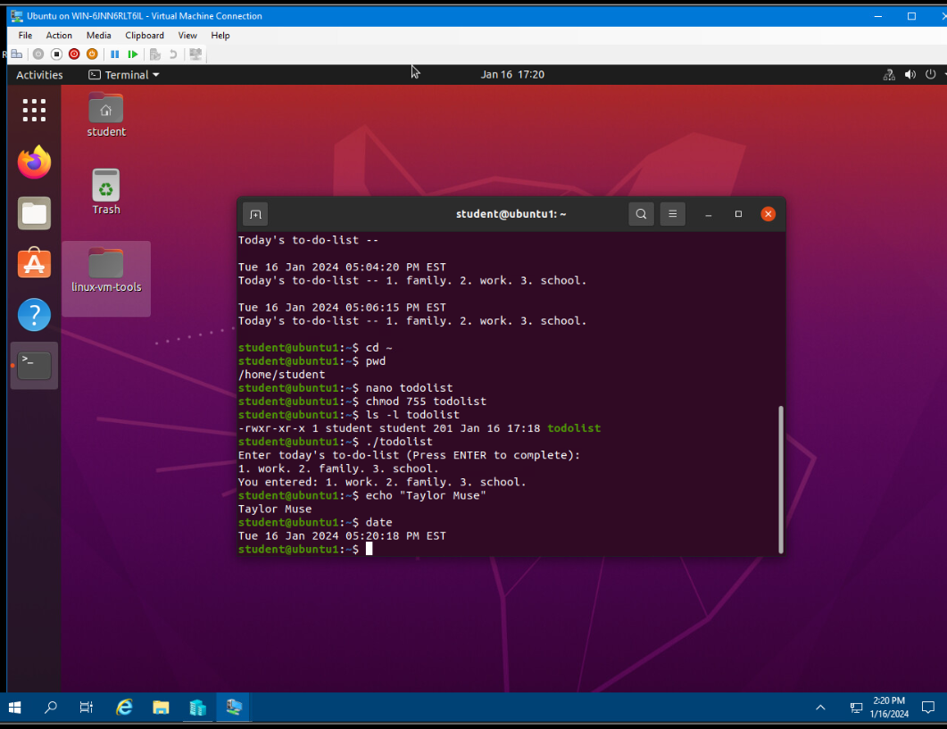
Change script file permissions

Slide 12
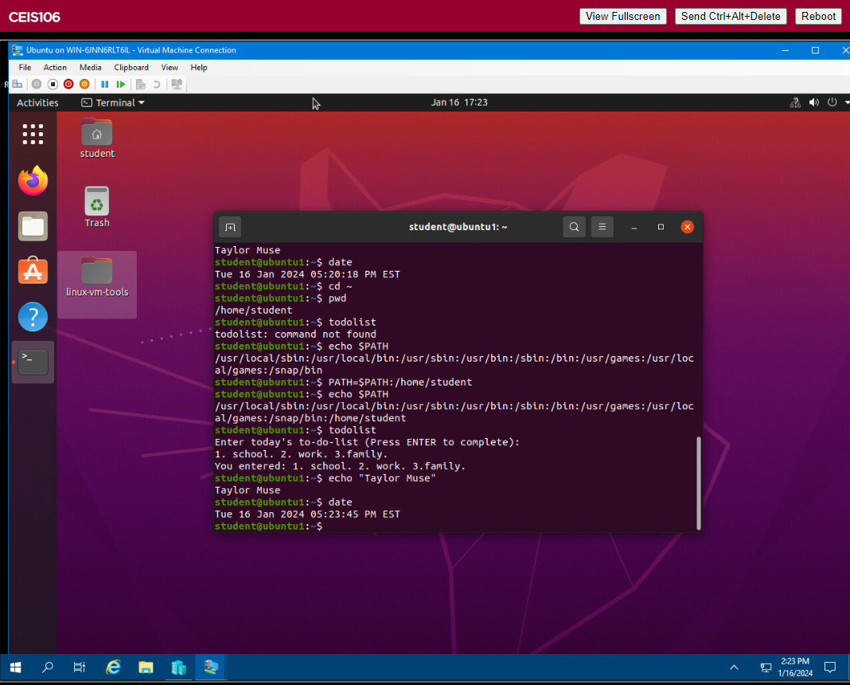
Set the PATH variable
Take a screenshot of the output in Step 6.

Slide 13
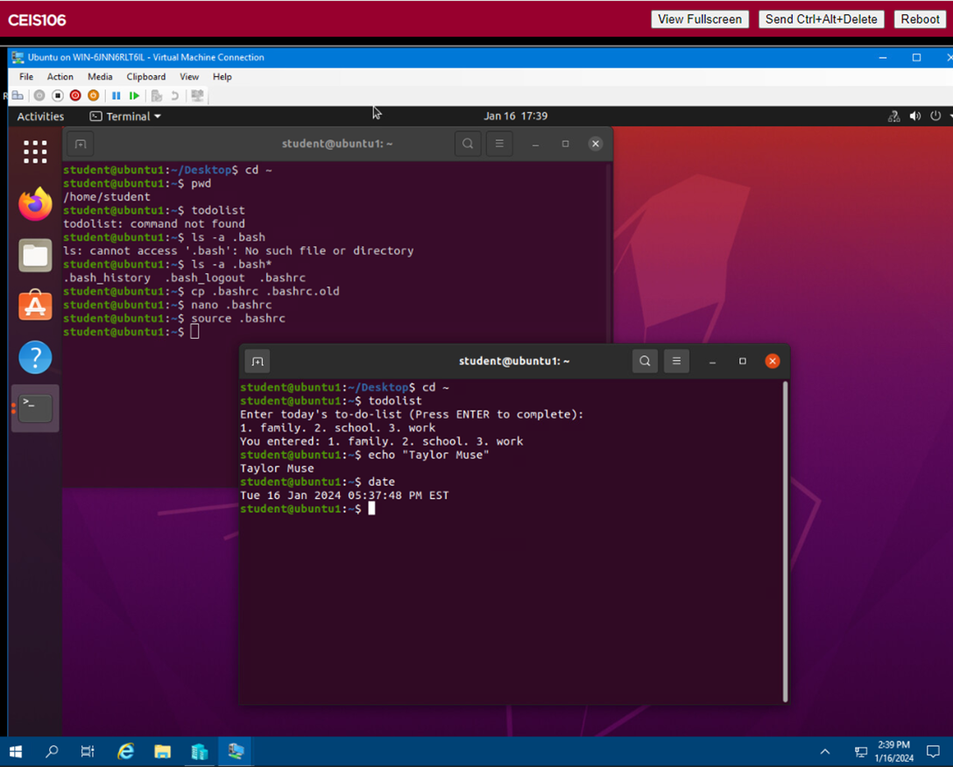
Make the PATH variable permanent

Slide 14
Module 3 summary
Changed script file permission so that the user is able to read and execute the script and the group permission is read only
Set a path variable to add the student profile to the $path command for bash commands
Made the path variable permanent

Slide 15
Course Project
Operating Systems
Module 4 User and Group Management

Slide 16
Add users and groups in CLI
1. What does the –m option in the useradd command do?
Answer here: creates users home directory
2. What does the -3 option in the tail command do?
Answer here: displays the last 3 lines of the file identified
3. Which line of the /etc/group file lists members of the “students” group? Copy it here.
Answer here: students:x:1002:student,mary or the last line
References:
1. Exkert, J. W. (2019). Linux+ and LPIC-1 Guide to Linux Certification(Fifth Edition). Boston: Cengage.
2. Linux man function

Slide 17
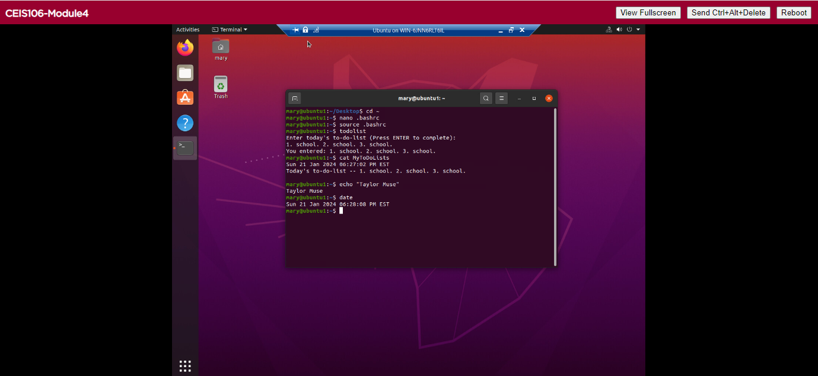
Test user and group settings

Slide 18
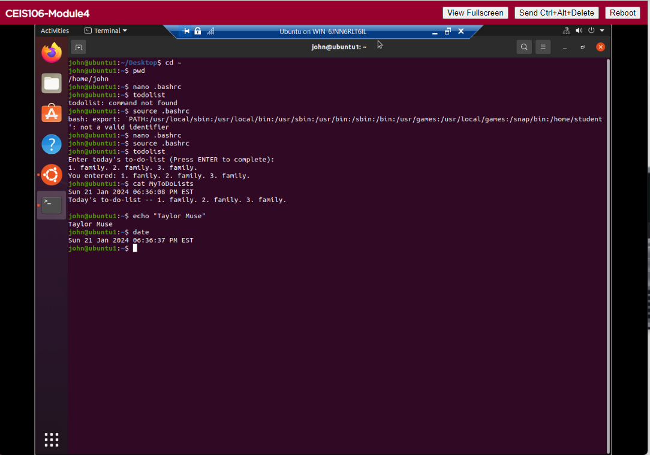
Add users in GUI

Slide 19
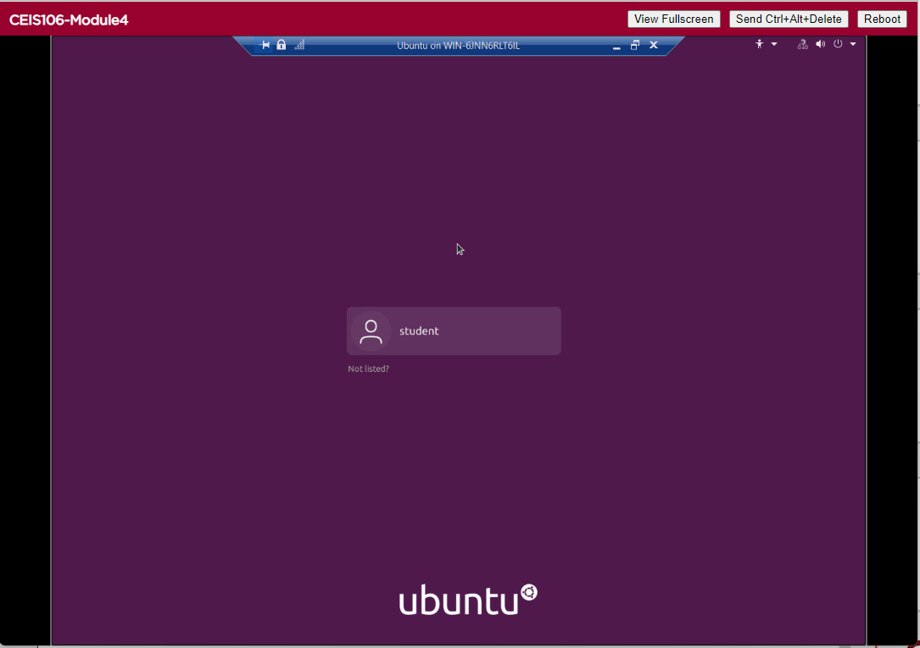
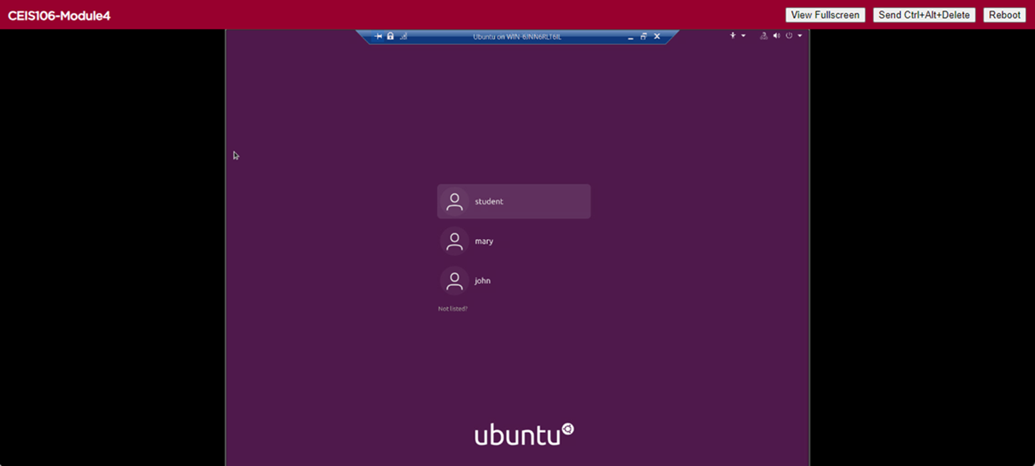

Remove users and groups

Slide 20
Module 4 summary
Ensured the script is executable for the user John and mary
Added users “John and Mary” in the GUI
Removed users “john and mary” and the student group

Slide 21
Course Project
Operating Systems
Module 5 Network Configuration
By: Taylor Muse

Slide 22
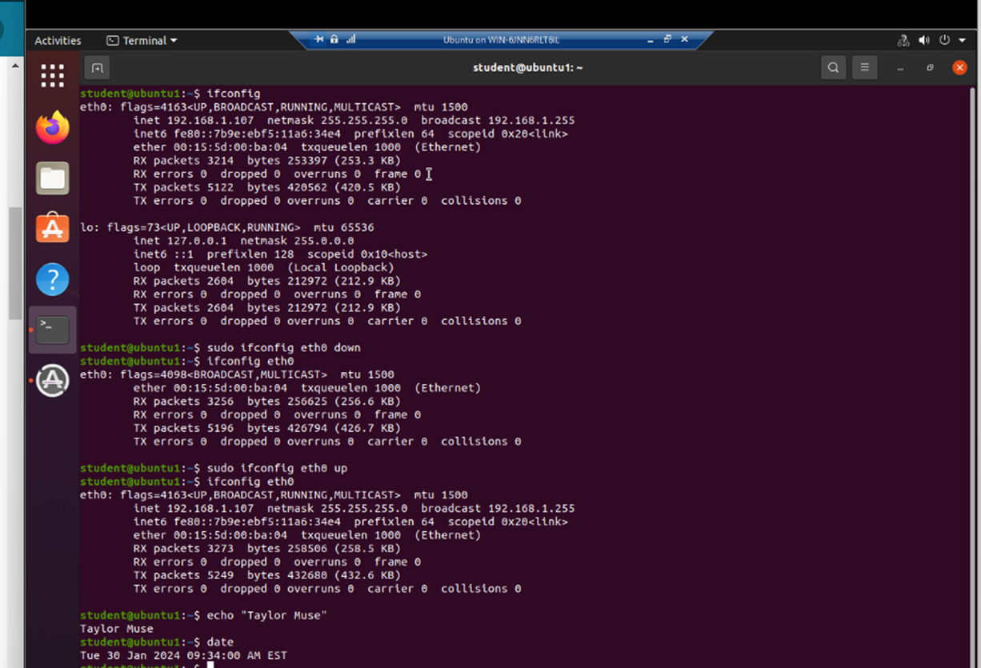
Discover host IP configurations
Take a screen capture of the output in Step 12.
1. What is the IP address of your Ubuntu machine?
Answer here: 192.168.1.107
2. What is the IP address of its default gateway?
Answer here:192.168.1.1
3. What is the IP address of its DHCP server?
Answer here: 192.168.1.1
4. What is the IP address of its DNS server?
Answer here: 192.168.1.1

Slide 23
Manage network interfaces
1. Which DHCP message is shown in the output of the sudo dhclient –v –r ens33 command?
Answer here: DHCP RELEASE
2. Which four DHCP messages are shown in the output of the sudo dhclient –v ens33 command?
Answer here:DHCPDISCOVER, DHCPOFFER, DHCPREQUEST, DHCPACK

Slide 24
Use network utilities
Take a screen capture of the output in Step 7 and Step 8.

Slide 25
Module 5 summary
Found the host IP addresses
Shutdown and started ports to disconnect and reconnect host utilities

Slide 26
Course Project
Operating Systems
Module 6 System Performance Monitoring

Slide 27
Monitor Linux processes
1. What is the default action of the 15 SIGTERM kill signal?
Answer here: 15 SIGTERM kill signal is the signal sent to terminate the application selected
2. In the System Monitor window, click on % CPU to sort the processes by CPU load. Which process shows the highest percentage of CPU usage?
Answer here: htop is using the largest capacity of the CPU with no applications running
References:
1. Exkert, J. W. (2019). Linux+ and LPIC-1 Guide to Linux Certification(Fifth Edition). Boston: Cengage.
2.

Slide 28
Monitor user activities
Issue the sudo accton on command to turn on GNC accounting. Run the sudo updatedb command. Enter lastcomm updatedb to check if the updatedb command was executed before. Remember to turn off GNC accounting (sudo accton off) after answering the questions.
1. What flag value is displayed in the output?
Answer here: the “S” flag is displayed as it was a superuser command
2. Why is the name of the user who ran the processes shown as root, not student?
Answer here: when issuing sudo commands it defaults to executing the command as root without having to leave the user profile
References:
1. Exkert, J. W. (2019). Linux+ and LPIC-1 Guide to Linux Certification(Fifth Edition). Boston: Cengage.
2.

Slide 29
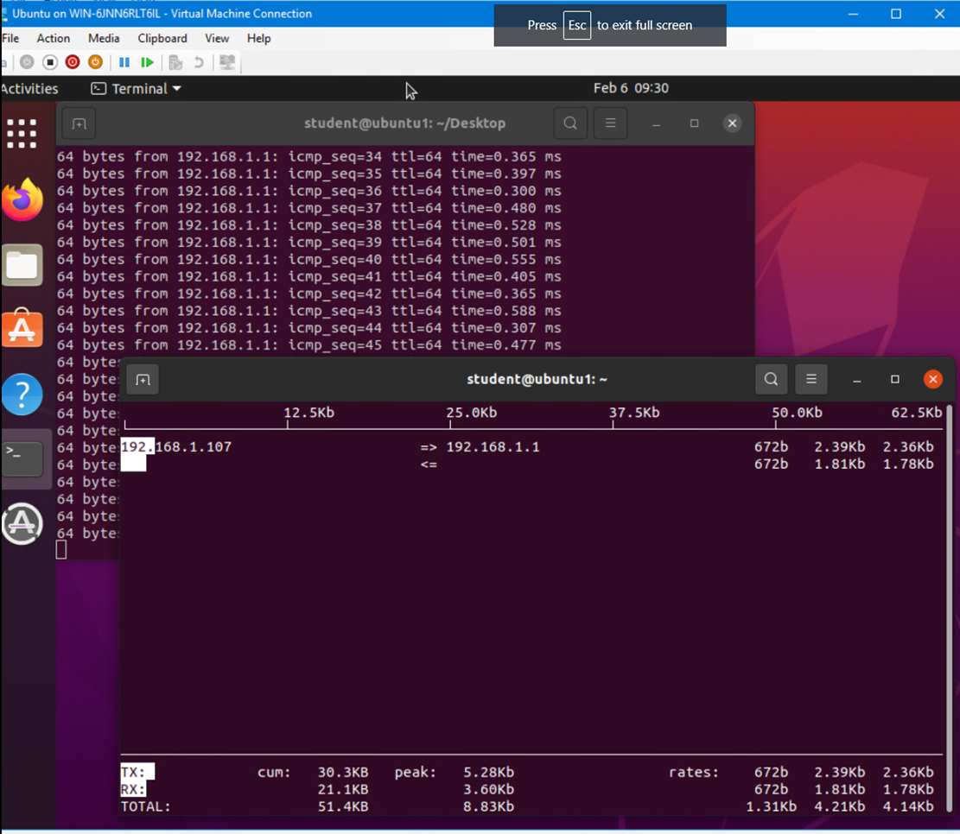
Monitor network bandwidth usage
Take a screenshot of the output in Step 4.

Slide 30
Module 6 summary
Started an application from the GUI, then stopped from the command prompt
Verified the highest CPU usage application running on the computer

Slide 31
Challenges/lessons learned
Learning the different types of Linux commands was the most difficult part for me, in the past I had used Linux for troubleshooting for work, but I had no experience with the bash commands and shell scripting.

Slide 32
Career skills
I learned attention to detail and procedural compliance from following the instructions of the course and doing every step in the correct order.
I also learned new SYSADMIN roles that will apply to most occupations that require Linux+ certification.

Slide 33
conclusion
In this course I learned many useful talents including copying directories, creating user profiles and how to check network usage.

Slide 34
references
Exkert, J. W. (2019). Linux+ and LPIC-1 Guide to Linux Certification(Fifth Edition). Boston: Cengage.

Slide 35
Wix profile
https://taylormuse03.wixsite.com/my-site-7

