Slide 1
Electric toothbrush of today design
By: taylor muse ect308

Slide 2
introduction
This presentation will walk you through my design process of an electric toothbrush that will change the way humans brush teeth FOREVER.
No longer will you have to rotate the toothbrush around the front and back of your teeth to clean them properly, as this toothbrush has a unique three-sided head that will scrub away plaque on all surfaces of your teeth in one pass!

Slide 3
AGENDA
Preliminary design
Charging base
Handle
Rigid Head
Head with bristles
Complete assembly
Conclusion
Challenges

Slide 4
Module 1
Preliminary design

Slide 5
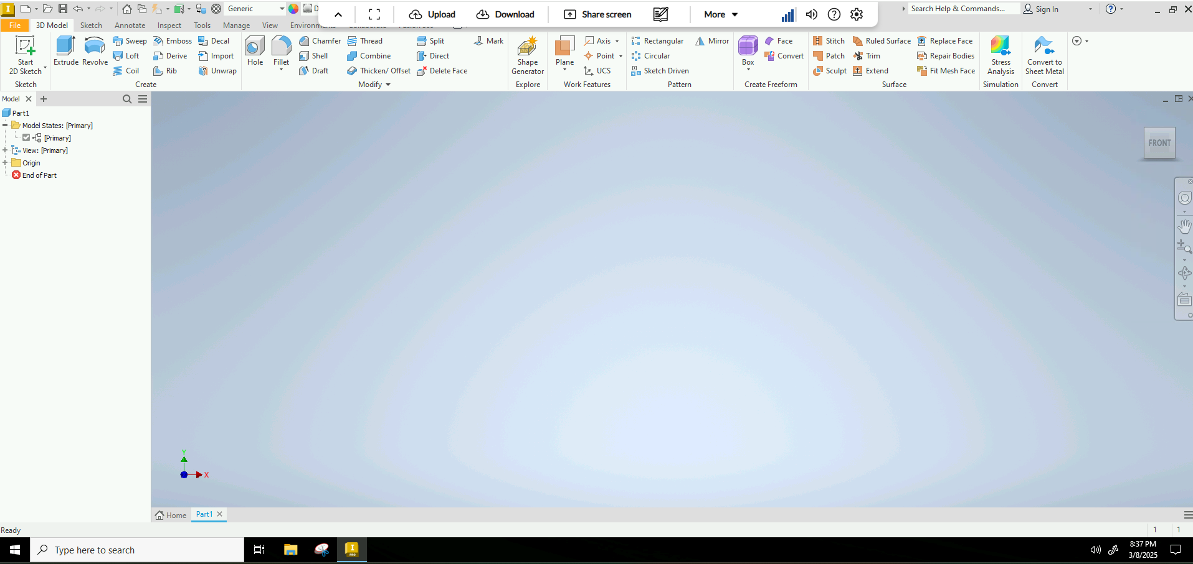
Choosing software: Autodesk Inventor

Slide 6
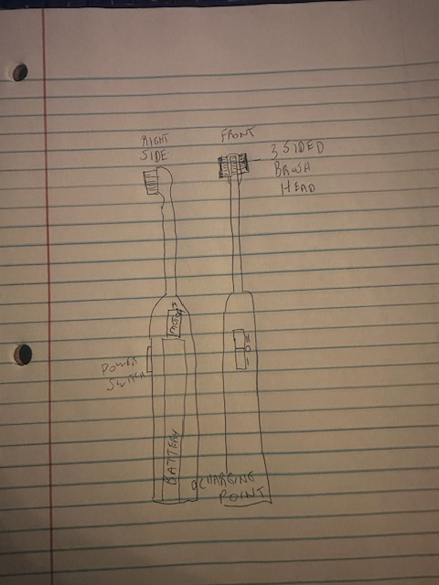
Preliminary Design. Hand-sketched Design

Slide 7
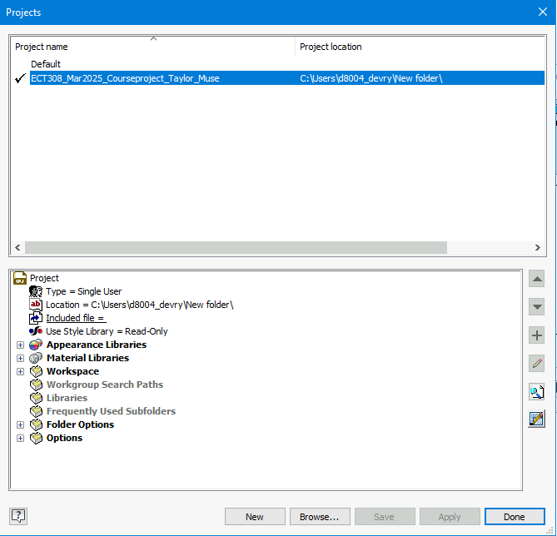
Screenshot of Project File Selection
Provide a screenshot of project file for the course project selected on the Home screen.

Slide 8
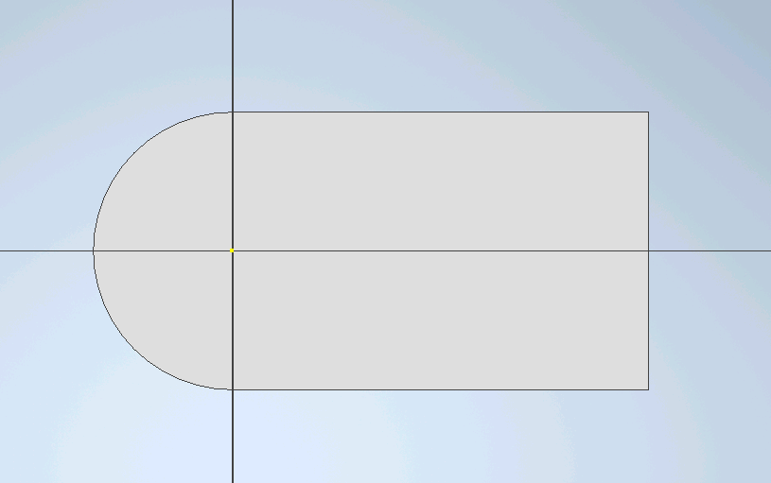
Screenshot of 2-D Sketch
Provide a screenshot of the 2-D sketch of the bottom profile of the toothbrush charging base.

Slide 9
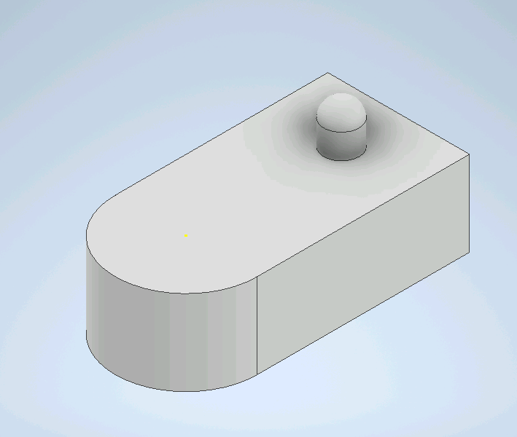
Screenshot of 3-D Sketch
Provide a screenshot of the 3-D sketch without your name on it.

Slide 10
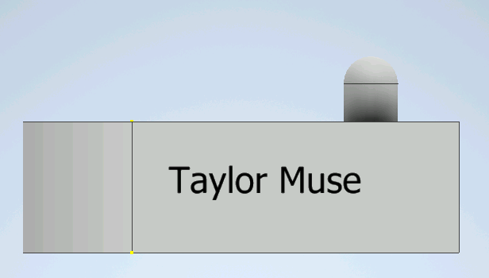
Screenshot of Name on Charging Base
Screenshot of the Charging base with your name visible on the part.

Slide 11
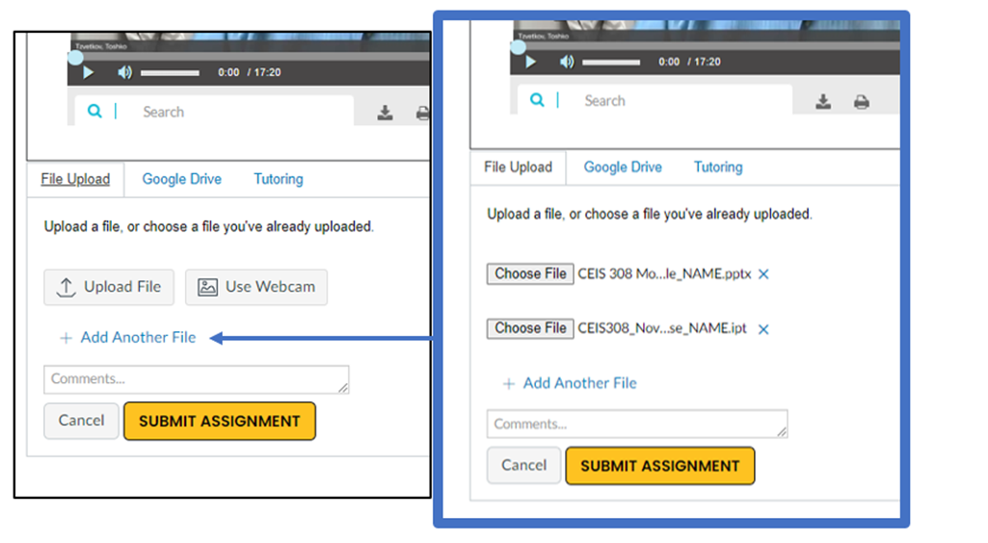
Part file
This slide is a reminder for you to provide a .ipt file of your charging base as a separate file. You do not need to include anything on this slide.

Slide 12
ECT308
Module 3
Project Plan for Electric Toothbrush
By: Taylor Muse

Slide 13
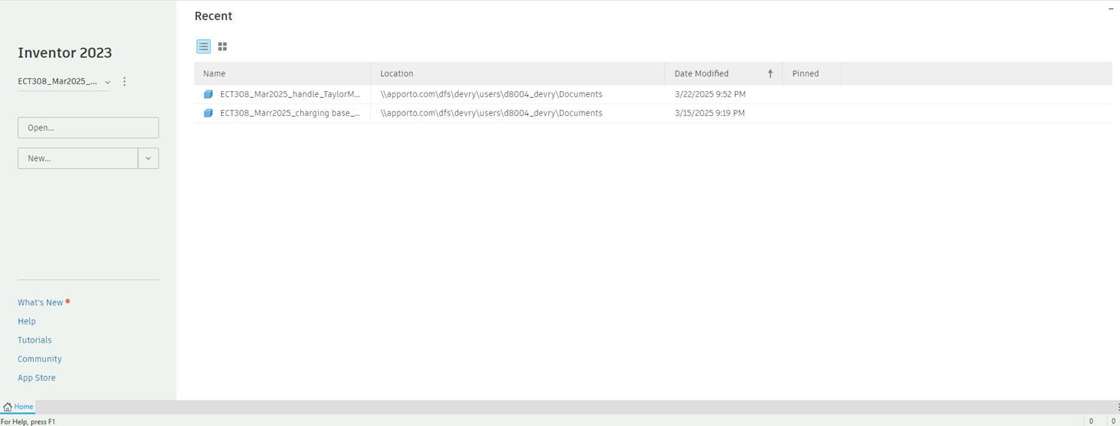
Selecting the Project File
Provide a screenshot of project file for the course project selected on the Home screen.

Slide 14
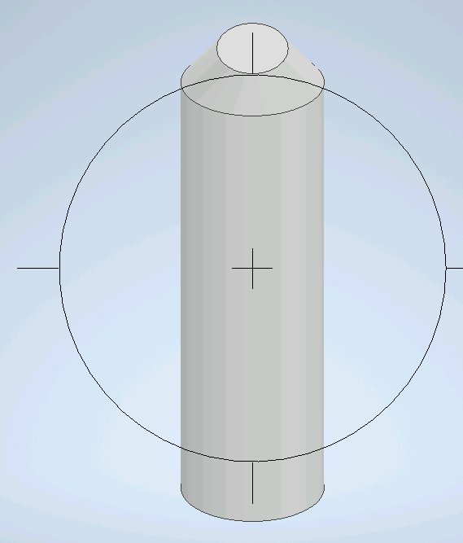
Basic 3-D Shape of the Toothbrush Handle
Provide a screenshot of the basic 3-D shape of the Toothbrush handle

Slide 15
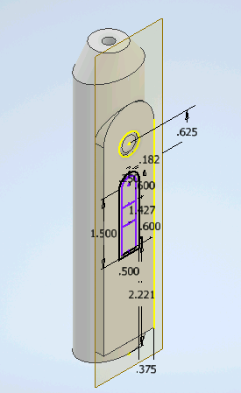
Detailed 3-D Design of the Toothbrush Handle
Provide a screenshot of the detailed 3-D sketch of the toothbrush handle. No name should be on the part in this screenshot.

Slide 16
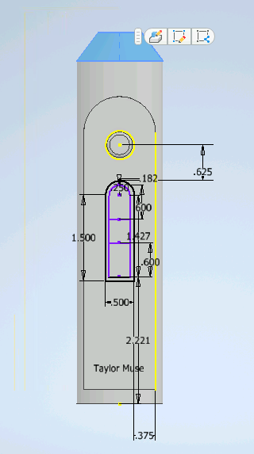
Name on the 3-D Part
Provide a screenshot of the part with your name visible.

Slide 17
ECT308
Module 4
Project Plan for Electric Toothbrush

Slide 18
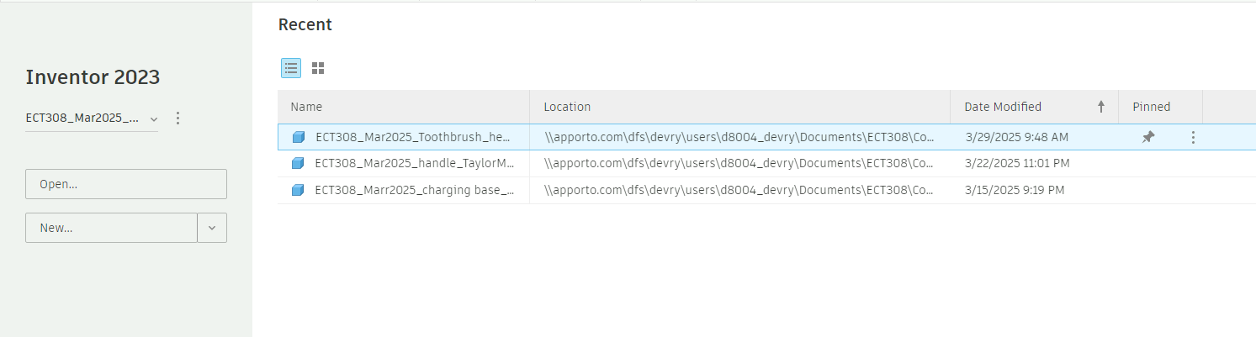
Selecting the Project File
Provide a screenshot of project file for the course project selected on the Home screen.

Slide 19
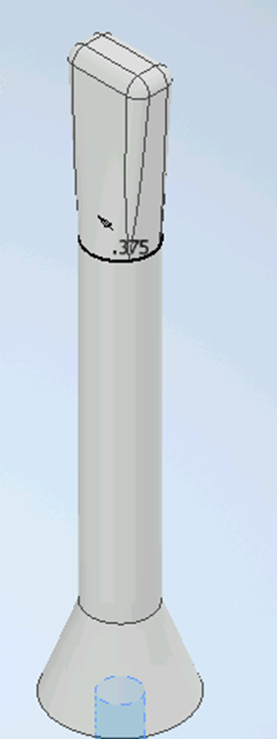
Basic 3-D Shape of the Ridged Toothbrush Head
Provide a screenshot of the basic 3-D shape of the ridged toothbrush head.

Slide 20
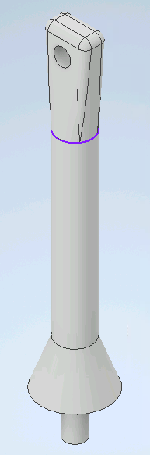
Detailed 3-D Design of the Ridged Toothbrush Head
Provide a screenshot of the detailed 3-D sketch of the toothbrush head. No name should be on the part in this screenshot.

Slide 21
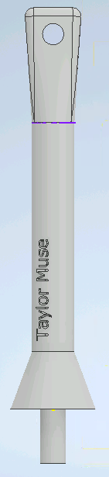
Adding Name to the 3-D Part
Provide a screenshot of the part with your name visible.

Slide 22
ECT308
Module 6
Project Plan for Electric Toothbrush

Slide 23
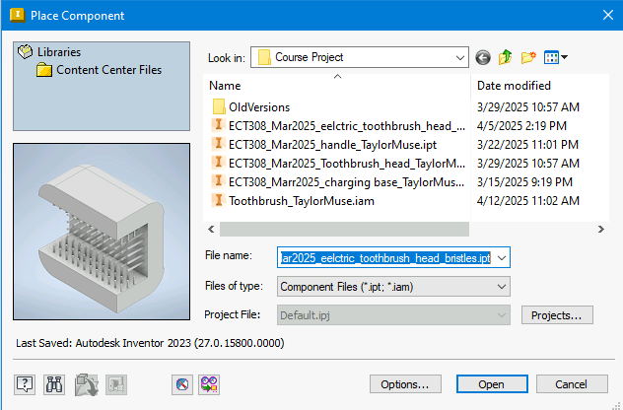
Place Component Window
Place screenshot of the Place Component window that shows all parts files are associated with proper project file

Slide 24
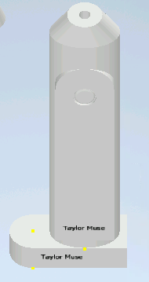
Charging Base and the Toothbrush Handle
Place a screenshot of the handle properly placed on the charging base.

Slide 25
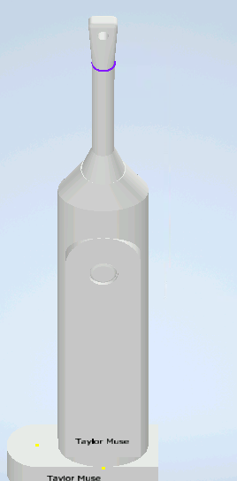
Toothbrush Handle and Ridged head
Place a screenshot of the toothbrush head properly placed on the handle.

Slide 26
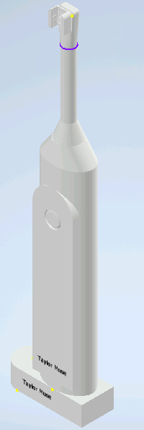
Complete
Place a screenshot of the complete assembly.

Slide 27
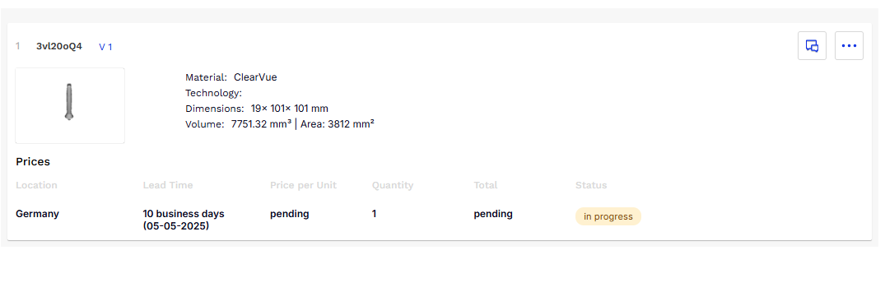
Quote for prototype
I submitted a request for a quote to have a prototype 3D printed and this is the response from the quote.

Slide 28
Conclusion
Throughout this course I was able to rehone my CAD skills and learned a few new skills. I enjoyed designing this electric toothbrush and the ability to create my own vision within it.

Slide 29
Challenges overcome
The biggest challenge I faced was in the final assembly, after putting all the pieces together I realized some of the dimensions needed to be changed for the toothbrush to go together correctly
-The base had to be made longer to fit the handle entirely on top of It and the bristle head had to be edited to attach to the rigid head properly.

Slide 30

Career skills
-Microsoft Inventor Professional
-2D design
-3D design
-Computer automated design features
-Prototype assembly

Slide 31
THANK YOU
Taylor Muse
Taylormuse03@gmail.com
https://Taylormuse03.wix/my-site-7

