Slide 1
NETW310 Final Presentation
By: Taylor Muse
Professor Eric Addeo

Slide 2
Introduction
Throughout this course I have honed in my skills and understanding of how AM and FM signals are transmitted and also how to measure and interpret those signals using an oscilloscope and spectrum analyzer.

Slide 3
NETW310 Course Project
Module 2
Baseband Signals and AM/FM Signals

Slide 4
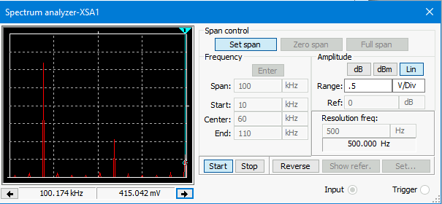
Baseband Signals
The screenshot should show the spectrum analyzer displaying the signal’s harmonic spectrum and its panel settings. Record the signal voltage at each of the frequencies in the table.
Harmonic Frequency | Signal (Volts)
20 kHz | 3.13V
40 kHz | 0.00v
60 kHz | 868.903mV
80 kHz | 0.00v
100 kHz | 416.689mV

Slide 5
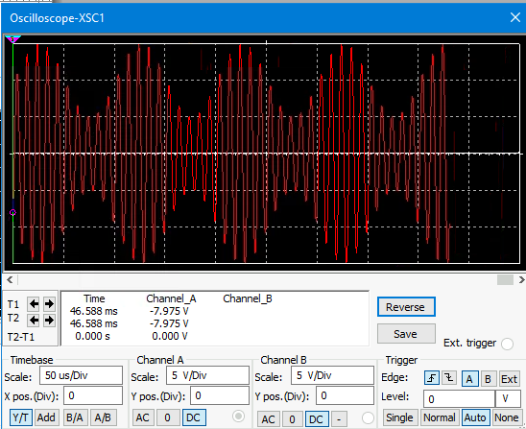
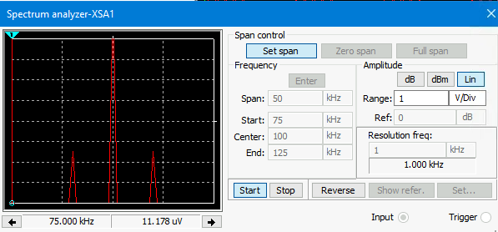
AM Signals
The screenshot of the Oscilloscope should include the signal and the panel settings of the oscilloscope. The screenshot of the Spectrum Analyzer should include the signal and the panel setting of the analyzer.
Oscilloscope screenshot here
Spectrum Analyzer screenshot here
AM Modulation | Frequency (kHz)
Lower side band | 90.083kHz
Carrier | 100.00kHz
Upper side band | 109.917kHz

Slide 6
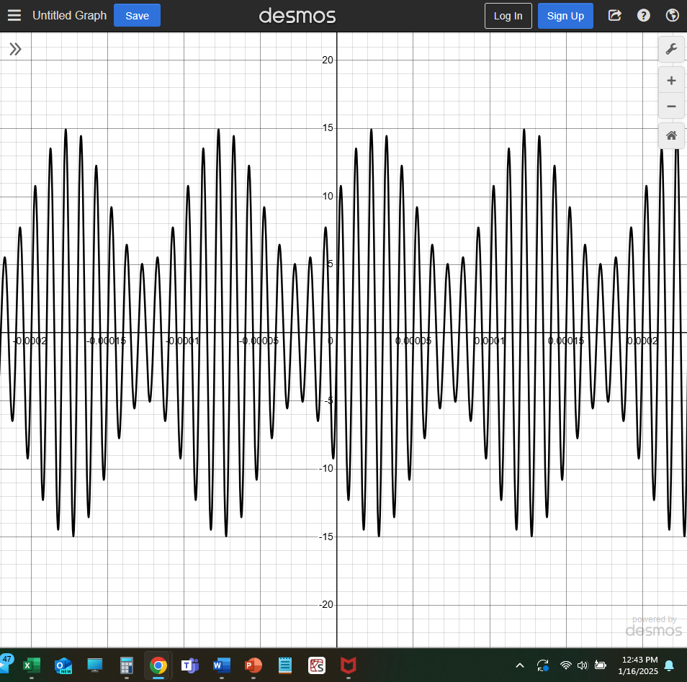
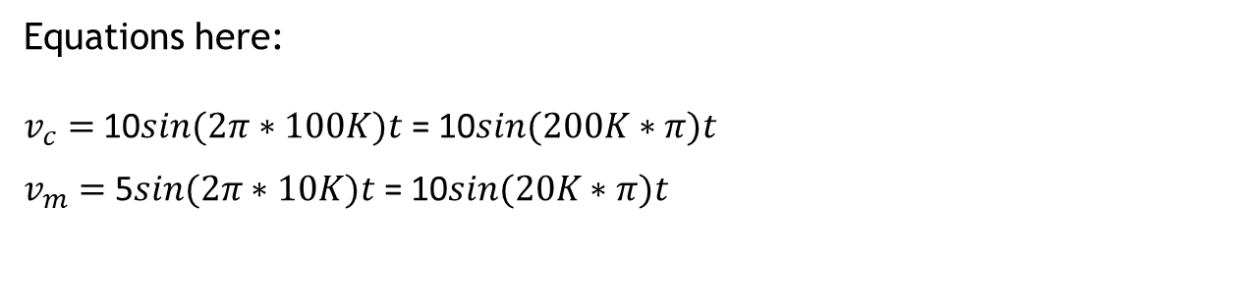
AM Signals Cont.
Develop equations for the carrier and modulating signals and plot the equation for the composite modulated signal V_{AM .}
Equations here:
$v_{c}=$10$sin(2π∗100K)t$= 10$sin(200K∗π)t$
$v_{m}=$5$sin(2π∗10K)t$= 10$sin(20K∗π)t$

Slide 7
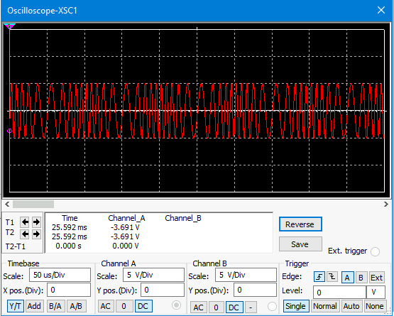
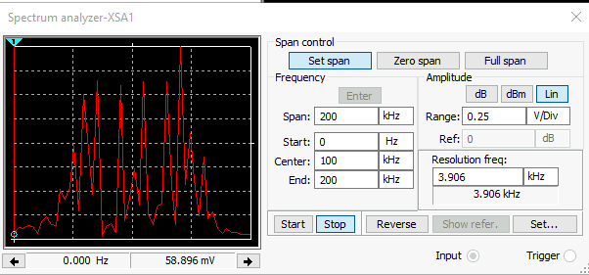
FM Signals
The screenshot of the Oscilloscope should include the signal and the panel settings of the oscilloscope. The screenshot of the Spectrum Analyzer should include the signal and the panel setting of the analyzer.
Oscilloscope screenshot
Spectrum Analyzer screenshot
What’s the carrier frequency?
100kHz

Slide 8
NETW310 Course Project
Module 3
Pulse Code Modulation (PCM) and Line Codes

Slide 9
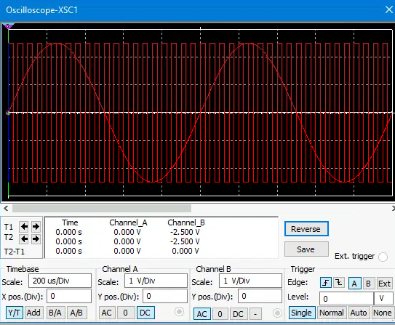
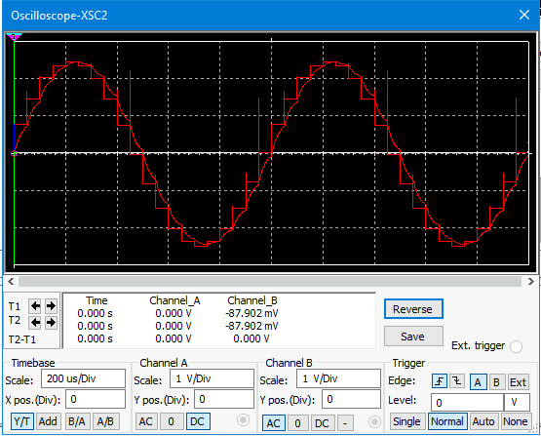
Pulse Code Modulation (PCM)
The first screenshot should show the Oscilloscope-XSC1 display with the analog input signal and sampling clock at the input to the ADC. The second screenshot should show the Oscilloscope-XSC2 display with the output of the DAC.

Slide 10
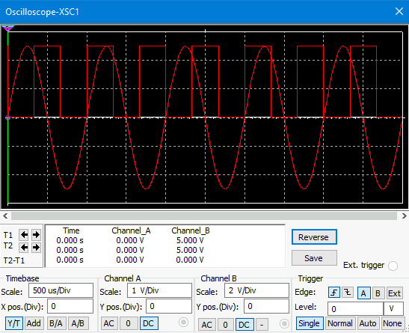
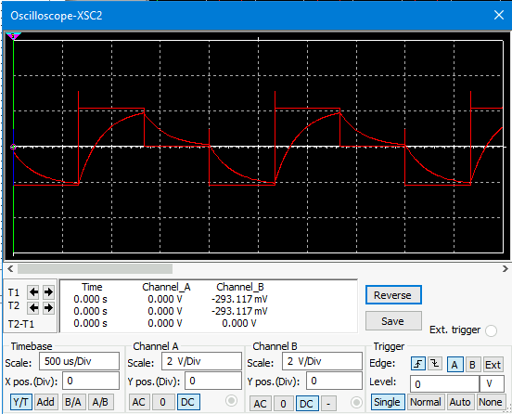
Pulse Code Modulation (PCM)
The first screenshot should show the Oscilloscope-XSC1 display with the analog input signal and sampling clock at the input to the ADC. The second screenshot should show the Oscilloscope-XSC2 display with the output of the DAC.
What are the effects of increasing or decreasing the sampling rate?
Answer:
Increasing sampling rate will increase the probability that the signal can be successfully recovered on the receiving end. This signal was under sampled and the output or second screenshot shows that the signal looks very different because the sampling rate is not at least twice the amount of the information frequency.

Slide 11
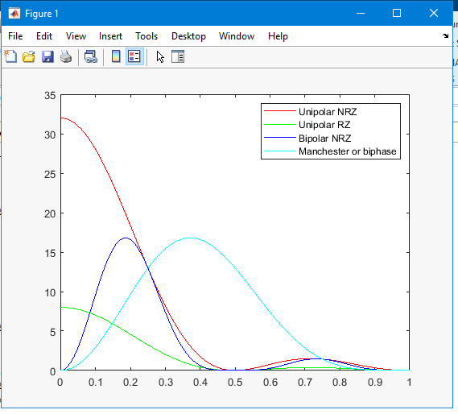
Line Codes
This screenshot should show the power spectral densities of four-line codes: NRZ-Polar, NRZ-Unipolar, NRZ-Bipolar, and Manchester-Polar.
MATLAB Diagram Here
Compare the NRZ-Bipolar and Manchester polar codes in the diagram.
Which one requires more bandwidth?
Answer:
The Manchester polar would require more bandwidth than the NRZ bipolar

Slide 12
NETW310 Course Project
Module 4
Cables and Structured Cabling

Slide 13
Questions
1. Why must the twisting in the individual wires be maintained in a UTP cable?
Answer: The twists in an Unshielded Twisted Pair (UTP) must be maintained to minimize interference or crosstalk from the other strands.
2. How many inches should UTP cable be separated from 110 volts electrical cable?
Answer: unshielded twisted pair cables must be running at least eight inches from 110V electrical cable and twelve inches from 220V electrical cable.
3. Horizontal cabling connects what areas to each other?
Answer: Horizontal cabling supplies connectivity from the work area outlet to the telecommunication room or server room from which the internet connectivity is routed through the DMZ and to the internet service provider or internal networks.

Slide 14
Questions
4. What is a plenum rated cable?
Answer: a plenum rated cable is designed using a low-smoke and low flame insulator for use within air plenums. Air plenums are defined as the space above a ceiling and below the roof or next floor above in which air is designed to flow. Air plenums are considered a very dangerous area of a structure because if a fire was to spread to an air plenum it could travel faster than the firefighting team could respond to the emergency.
5. What is a riser tube used for?
Answer: A riser tube is used in a riser shaft or vertical space behind wall for wiring to travel. The tube is designed to protect all the cables passing through from EMI, intrusion and from fire that starts in the rooms the riser travels near.
6. Is the grounding of equipment mostly a safety or a performance concern?
Answer: Grounding is essential for safety concerns, if a wire was to short out or become exposed due to failed insulation the exposed wire touching any metal should protects cause a breaker to trip or fuse to blow. If the chassis of the equipment or shielding of the wire was not connected to ground, you would have the potential for electrical shock to occur to the personnel operating the machine or to the equipment itself which could destroy electrical components.

Slide 15
NETW310 Course Project
Module 5
Antenna Gain and Free Space Path Loss

Slide 16
Antenna Gain
1. What is the maximum theoretical antenna gain of a common dish antenna at the 2.4 GHz band? [4 points]
Answer: 22.379 dB
2. What is the maximum theoretical antenna gain of a common dish antenna at the 5 GHz band? [4 points]
Answer: 29.079dB
3. Given the same sized reflector, which signals, high-frequency, or low-frequency, can be more efficiently focused by a common dish antenna (i.e., result in a higher antenna gain)? [5 points]
Answer: Higher frequency can be more efficiently focused
4. What is the maximum theoretical antenna gain of the dish antenna used in the VLA radio telescopes in New Mexico at the 5 GHz band? [4 points]
Answer:63.059dB
5. Given the same signal frequency, which dish antennas, large-sized or small-sized, are more efficient at focusing the signal (i.e., result in a higher antenna gain)? [5 points]
Answer: The larger the antenna diameter the more efficient at focusing a signal the antenna will be

Slide 17
Free Space Path Loss
1. What is the free space path loss in dB at the 2.4 GHz band? [4 points] Answer: -80.4dB
2. What is the free space path loss in dB at the 5 GHz band? [4 points] Answer: -87.2dB
3. How does the free space path loss at a higher frequency (e.g., the 5 GHz band) compare with that at a lower frequency (e.g., the 2.4 GHz band)? [5 points]
Answer: Free space loss is more significant at higher frequency than lower frequency.
4. What is the free space path loss in dB over 20 meters at the 2.4 GHz band? [4 points]
Answer: -66.421dB
5. What is the free space path loss in dB over 40 meters at the 2.4 GHz band? [4 points]
Answer: -72.441dB
6. What is the free space path loss in dB over 80 meters at the 2.4 GHz band? [4 points]
Answer: -78.462dB
7. When the distance doubles, how does free space path loss in dB change approximately? [5 points]
Answer: When the distance doubles the free space is reduced by approximately 6 dB

Slide 18
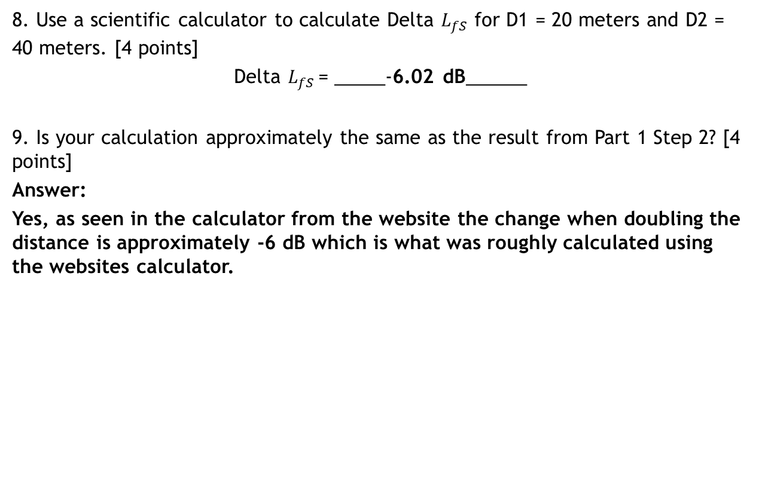
Free Space Path Loss Cont.
8. Use a scientific calculator to calculate Delta $L_{fS}$ for D1 = 20 meters and D2 = 40 meters. [4 points]
Delta $L_{fS }$= _____-6.02 dB______
9. Is your calculation approximately the same as the result from Part 1 Step 2? [4 points]
Answer:
Yes, as seen in the calculator from the website the change when doubling the distance is approximately -6 dB which is what was roughly calculated using the websites calculator.

Slide 19
NETW310 Course Project
Module 6
Bit Error Rate of Fading Channels

Slide 20
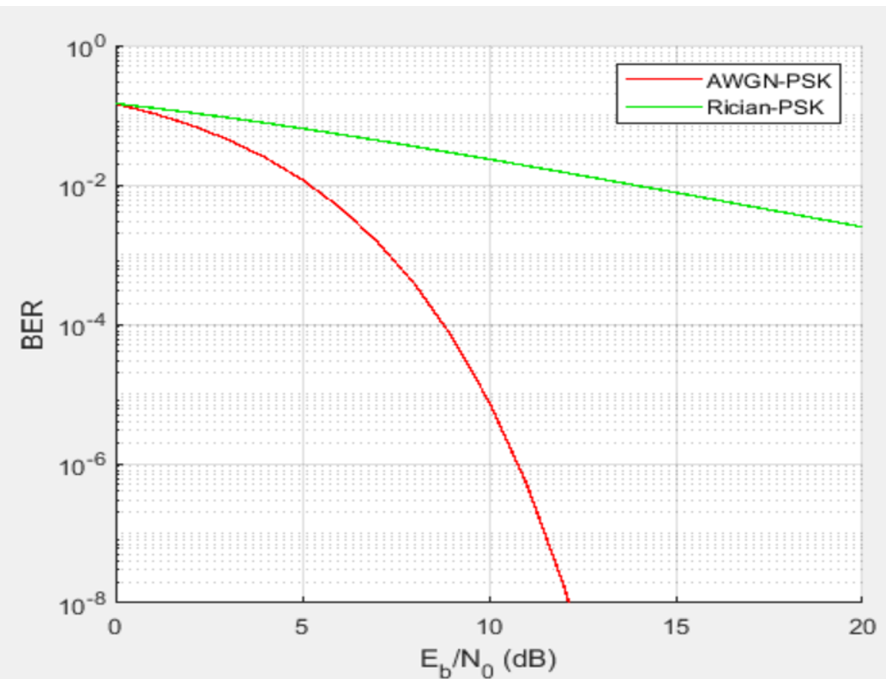
AWGN Channel and Rician Channel
This screenshot should show the bit rate error performance of both AWGN and Rician fading channels.

Slide 21
AWGN Channel and Rician Channel
Compare and contrast the BER performance of PSK over a noise limited (AWGN) transmission channel to the performance of PSK over a Rician channel at 5- and 10-dB Signal to Noise Ratio (E_{b}/N₀), respectively.
Is there a significant difference in BER performance of PSK between the AWGN channel and Rician channel?
Answer: in comparison the AWGN Bit-Error rate drops significantly between -5dB and -10dB while the Rician fade signal stays consistent throughout the duration of the test captured. This shows that while power increases the Rician signal is still not improving. The two signals start off with a similar BER which is losing about half of the bits being transmitted and the AWGN signal drops to a BER of approximately 1/100000000 bits being lost at only about -12db. Which means very little power is needed to almost completely eliminate Bit error in the signal.

Slide 22
References
1. Frenzel, L. E. (2016). Principles of Electronic Communication Systems, Fourth Edition. New York, NY: McGraw Hill.
2. Barnett, D., Groth, D., & McBee, J. (2004). Cabling: The Complete Guide to Network Wiring, Third Edition. San Fransisco: Sybex Inc.
3.https://web.anixter.com/AXECOM/AXEDocLib.nsf/(UnID)/8F2E0839A6190F4986257309005757CC/$file/ANSI-TIA-EIA-568-B.pdf
4. Network Cable Standards: TIA568
5. Mathias Coinchon. (2003, January 01). Radio theory and link planning for Wireless LAN (WLAN). Retrieved from Swiss wireless: http://www.swisswireless.org/wlan_calc_en.html
6. Engageli Live Lessons

Slide 23
Challenges
This course brought many challenges to light for myself including;
  Calculating the appropriate equations to represent the composite AM sine wave
  Calculating the dB loss of a signal based on distance and radar configurations

Slide 24
Career Skills
With the help and guidance of Professor Addeo I was able to achieve a greater understanding of AM and FM signal transmission and how to interpret the test equipment's readings to make decisions based on those readings.
Oscilloscope proficiency
Spectrum analyzer proficiency
Interpretation of Bit Error Rate of AWGN and Rican channels

Slide 25
Conclusion
At this point in my educational journey I have a great understanding of advanced electronics and this class was super insightful on the world of transmission types such as fiber optic and RF energy.
I have been able to overcomes obstacles in this class and have a greater understanding of how to use test equipment and how to interpret the signals being read.

