Slide 1
ECT315
Module 6-7-8
IoT Factory environment monitoring system Using TinkerCad, MATLAB and ThingSpeak
Student Name: Taylor Muse
Session:10742

Slide 2
Final Project due Saturday of Week 8
1. This PowerPoint Deliverable is just a component of the Final Project.
2. Your final presentation should explain your project in detail and illustrate all the details. Do not forget to develop slides to transition and explain each stage of the development process and customize your presentation to reflect a professional appearance.
3. You also need to include an introduction slide, conclusion slide, challenges in the project slide, and career skills obtained slide.
4. You should have around 15 - 20 slides.

Slide 3
Submission Requirements
Screenshot of TinkerCad Constructed Circuit | Picture of the circuit with all components
Screenshot of the constructed circuit showing smoke around the Gas sensor | Picture of the circuit with all around the Gas sensor while the Simulation is running
Screenshot of the constructed circuit showing Red Led Is ON detecting Temperature | Show Red LED is ON
Screenshot of the Completed ThingSpeak dashboard Before Sending Data from | Show dashboard with titles and the lamp indicators
Screenshot of ThingSpeak dashboard Showing plots after all data has been Sent (See examples of sample data at the end of the project guide) | Show plots of temperature and gas with their lamp indicators
Screenshot of MATLAB Plot of the collected Data | Data plotted on MATLAB should look like the ThingSpeak plots. This confirms data sent with no errors

Slide 4
Introduction
For the completion of this final project, I used TinkerCAD to build a circuit that will use a gas detector, temperature sensor and alarm and led for indications. The circuit will set off the alarm if the smoke is within a certain distance from the gas detector and If the temperature reaches the determined value. To test that the code is working properly to activate the audio and visual alarms I will adjust the location of the smoke and adjust the temperature on TinkerCAD.
Then I created a Thingspeak dash for this project and linked them together to monitor the data and show when the sensors read above a certain level as well as it being displayed on a histogram.

Slide 5
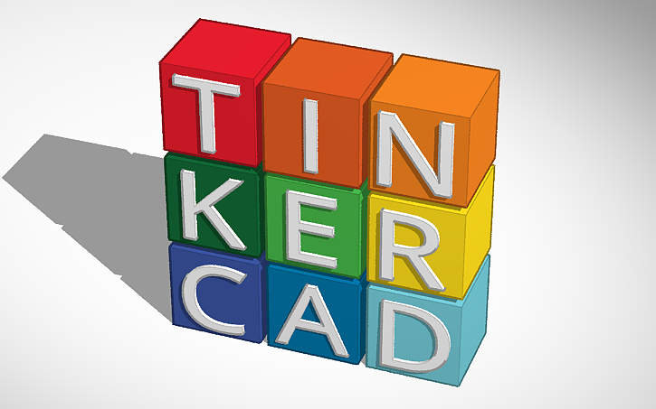
Tinkercad
In the next 3 slides you will see the TinkerCAD design; The first slide is a screenshot of the circuit showing the wiring and physical setups of the design. You will also see a dark grey cloud of “smoke” being generated from TinkerCAD to simulate the presence of smoke.
The next slide is a screenshot of the code that was written to perform all the required functions for this process. And the last slide is showing the circuit running and reading a high temperature condition and illuminating the RED led.

Slide 6
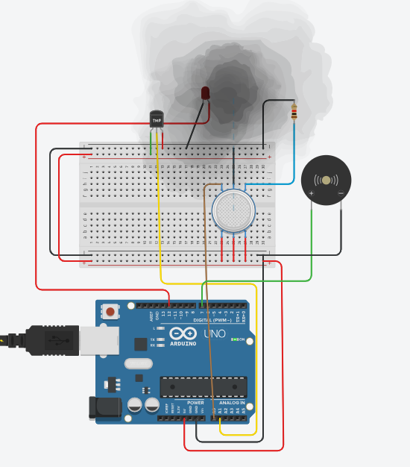
Screenshot of the constructed circuit showing smoke around the Gas sensor.
Temp sensor
Buzzer alarm
Gas Detector

Slide 7
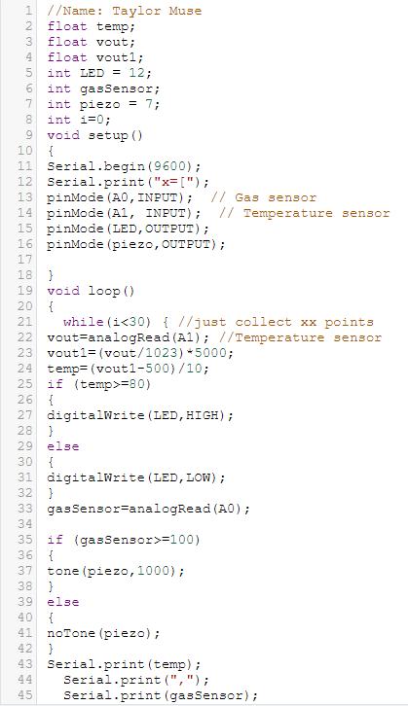
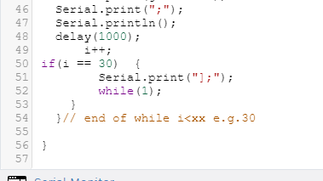
Screenshot of code from TinkerCAD

Slide 8
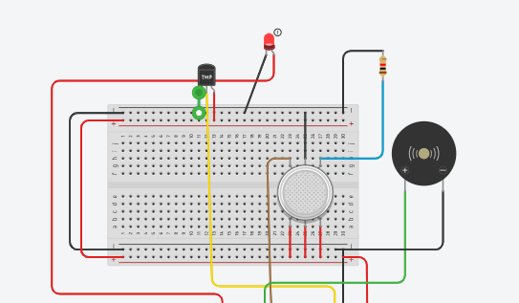
Screenshot of the constructed circuit showing Red LED Is ON detecting Temperature

Slide 9

Thingspeak
After running the simulation, testing the code, and collecting the data from the serial monitor the data then needed to be displayed on a Thingspeak dashboard. To do this the data was copied from the serial monitor on TInkerCAD and pasted into MATLAB where it was linked to a Thingspeak dashboard.
Below you will see the Thingspeak dashboard with widgets to display when the temperature exceeded 80 degrees and another indicator to represent when the gas sensor had a reading exceeding 100 ppm.
You will also see histograms showing the level being recorded each second for both the temperature sensor and the gas detector as the simulation was running.

Slide 10
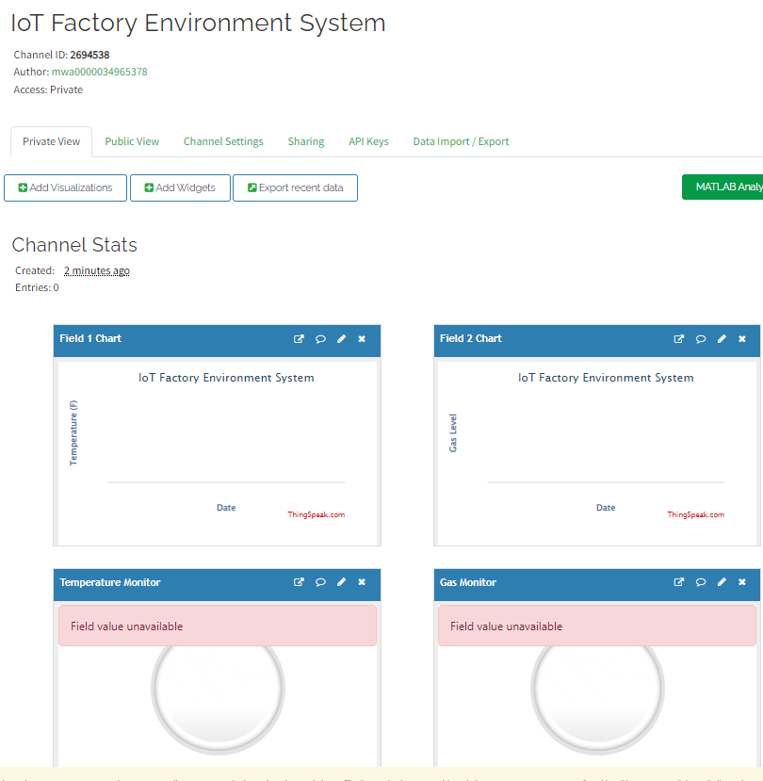
Screenshot of the Completed ThingSpeak dashboard Before Sending Data

Slide 11
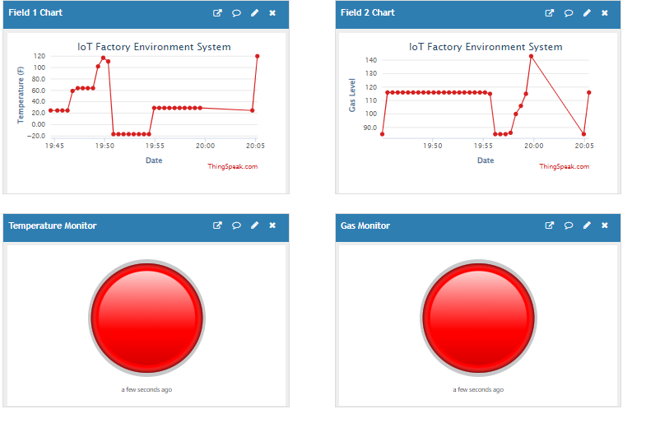
Screenshot of ThingSpeak dashboard Showing plots after all data has been Sent

Slide 12

MATLAB
Using the MATLAB software to send the data to Thingspeak will also create a plot from MATLAB showing the combined sensors as the simulation was ran. This is a good representation of both data sets for comparison and to develop conclusions in real world application as to what might have caused an event.

Slide 13
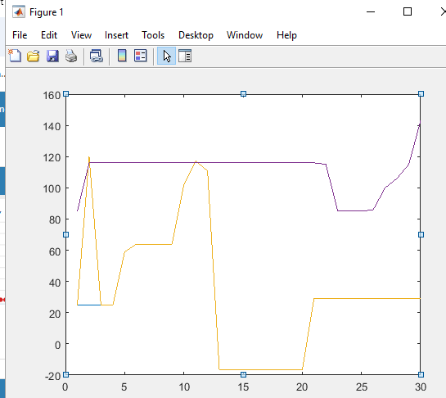
Screenshot of MATLAB Plot of the collected Data
Gas LVL
Sensor reading
Temp
Time (seconds)

Slide 14
Challenges overcome
One of the biggest challenges I faced with this project was using the functions of TinkerCAD, it took me a while to figure out how to use the smoke function for the sensor. After I figured out how to use the feature, I had to run the test four times to get a good display of collected data to demonstrate the Thingspeak functionality well.

Slide 15
Career skills
-MatLab proficiency
-Thingspeak functionality
-TinkerCAD demonstrations
-C++ coding experience

Slide 16
Conclusion
This project was very interesting, and I feel I was able to demonstrate all the principles that were learned throughout the class. From building the circuit and writing the code in TinkerCAD to collecting the data and linking MATLAB and Thingspeak to create a dashboard to monitor the system status. This project closed the loop on my understanding of how Industrial IoT systems will not only read the data but also transmit that data to other systems for evaluation and to be displayed for users and technicians. All of which will aide in troubleshooting and process improvement.

