Slide 1
SEC285 Final project
Author: Taylor Muse
Session:10400

Slide 2
Agenda
Introduction
Encryption
Firewall
Security Policy
Multi-factor Authentication
Vulnerability Assessment
Challenges
Career Skills
References
Conclusion

Slide 3
INtroduction
This Presentation is a demonstration of Information Security Fundamentals learned and represented over 5 projects.
You will see the use of encryption techniques, Firewall settings, building a security policy, and the implementation of multi-factor authentication, and using vulnerability assessments to identify issues within the network before issues arise.
To facilitate the use of these security principals I used virtual machines with emulators for kali and Ubuntu servers.

Slide 4
SEC285
Module 2
Asymmetric Key Encryption
Student Name: Taylor Muse
Session: 10400

Slide 5
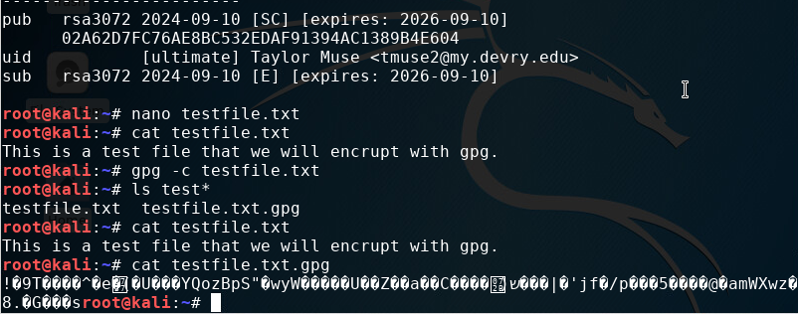
File encryption
To demonstrate what file encryption will look like as a user on the kali server, we used GPG encryption; after encrypting the file you should delete the plain text file, but we left it for demonstration purposes of what would be seen when a file is accessed for each of the options.

Slide 6
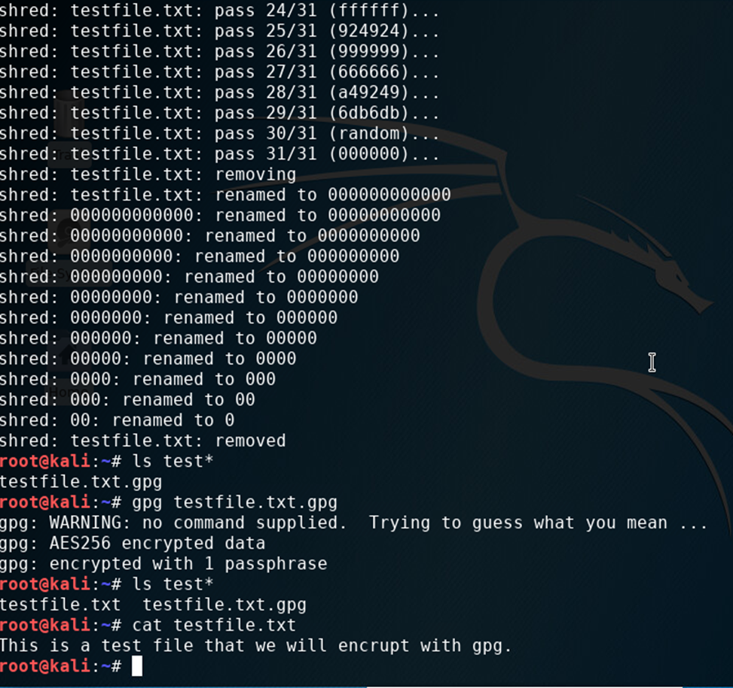
File decryption
When the file is needed to be accessed either for updates or to read as an admin you will have to decrypt the file. As shown in this screenshot of the process of decryption.

Slide 7
Module 2 summary
Using encryption is a great way to protect files from being accessed and the contents of those files from being read without proper authentication.
Another tool for protecting severs and information is Stateful firewall which is demonstrated in module 2.

Slide 8
SEC285
Module 3
Stateful Firewall

Slide 9
Question?
What effect does the sudo iptables --policy INPUT DROP command have on the access to computing resources?
Answer here: After applying the iptable firewall policy in place all ports are closed so that no incoming traffic is accessible to the machine, but the host is still running and available.
References:
Linux on IBM Systems. (2023, 11 28). Firewall iptables rules. Retrieved from IBM: https://www.ibm.com/docs/en/linux-on-systems?topic=tests-firewall-iptables-rules

Slide 10
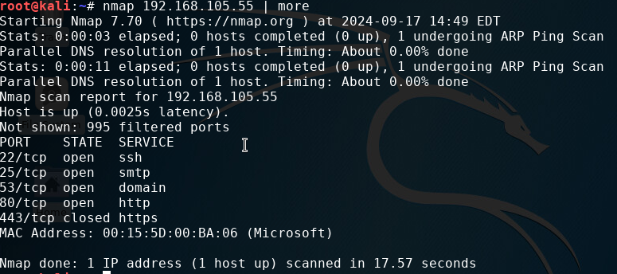
Nmap scan after applying stateful firewall settings
Nmap scan will show the status of all ports on the host identified in the command. This screenshot shows that port 443 is closed which would prevent any access from other hosts to that port.

Slide 11
Module 3 summary
In this module I used the iptables command to implement firewall controls. First I deactivated all ports with the input drop command which closed all ports from outside the machine. Then I reopened the ports and closed only port 443 for HTTPS.
In the next module I will show an example of a security policy that will outline the expected conduct of employees and outline what devices and apps are authorized to be used while at work.

Slide 12
SEC285
Module 4
Bring Your Own Device (BYOD)
Security Policy
Author: Taylor Muse
Session: 10400

Slide 13
BYOD security Policy
In this module we created our own Bring your own device (BYOD) security Policy. Establishing a workplace security policy is one of the key elements of prevent accidental spillage of information or exposing vulnerabilities to the companies' servers.

Slide 14
Overview:
In most modern companies, including our own, Mobile devices are used by every employee in some capacity. These devices bring great advantages for completing work remotely from home as well as maintaining communication when on travel. Although there are certain benefits from using these devices, there are also certain inherent risks involved when using mobile devices for company work. Some of the work that is conducted within our company is sensitive in nature and could be jeopardized through the use of malware, spyware, and a multitude of viruses. This policy will identify the steps our company will take to ensure an even handoff between employee functionality and securing our information and devices to the highest degree possible. This policy applies to all persons accessing information on ABC servers to include but not limited to: Employees, Contractors, Volunteers and Interns.
2. Purpose:
The main goal of any IT security policy is to protect confidentiality, integrity, and availability (CIA) of data. This policy will set the standard for procedures and protocols for employees who will access company information from their mobile devices which fall under the following classifications: Laptops (personal), Tablets (iPad, android tablet, Windows surface books, any device that is touchscreen and traditionally does not have an attached keyboard.), Smartphones (any cellular phone with internet connectivity features), as well as any storage device that will be used on the company servers on either personal or work assets(USB drives, SD cards, removeable Hard Drives). Some vulnerabilities to these devices include Theft, Loss, copyright, Malware and privacy compliance violations.

Slide 15
3. Scope:
This policy applies to all personnel as outlined in the overview section as well as any person who wishes to access, store, or move and data store on ABC servers. Breaching the terms stated in the Policy section will constitute a breach of trust and can be cause for termination or revocation of BYOD privileges.
All personnel who wish to use a personal mobile device must receive written approval from their department head or from the IT supervisor if not an employee of ABC. Access for personal mobile devices will only be granted for access to complete your designated tasks or assignments within the duty of your position and greater access will not be granted without written permission from your department head. The use of personal mobile devices will only be authorized when working off-site or when working from home, using your personal devices on ABC property to accomplish tasks that can be accomplished using ABC assets will not be authorized.
4. Policy:
All devices shall be screened to verify the most current Operating System (IOS, Android, or Windows) updates are installed, antivirus software and a firewall is in place prior to authorization of the device on the network by a member of the IT team. When using the devices for company matters Virtual Proxy Networks (VPN) will not be authorized. Any device that fails to meet the previously stated requirements will not be authorized to connect to ABC servers or assets until corrections are made. A member of the IT team can help in getting your security measures up to date.

Slide 16
5. Policy Compliance:
All devices used on ABC servers are subject to security screening and random audits of information. Failure to comply with an audit or screening will result in immediate termination and possible legal repercussion if deemed necessary. All devices are subject to search of all data stored within the device and the cloud servers that it is connected to if illegal or inappropriate use of ABC information is believed to be used.
Every case will be handled fairly and investigations into violation will be monitored by the IT supervisor, disciplinary action will be decided based on the gravity and intent behind the violation. All actions taken by the IT Supervisor are subject to appeal by Human Resources.

Slide 17
6. Related Standards, Policies, and Processes:
As the scope of our mission includes accepting payments via Credit Card PCI-DSS regulations apply as stated below:
-Install and maintain a firewall configuration to protect cardholder data
-Do not use vendor-supplied defaults for system passwords and other security parameters
-Protect stored cardholder data
-Encrypt transmission of cardholder data across open, public networks
-Use and regularly update anti-virus software or programs
-Develop and maintain secure systems and applications
-Restrict access to cardholder data by business need to know
-Assign a unique ID to each person with computer access
-Restrict physical access to cardholder data
-Track and monitor all access to network resources and cardholder data
-Regularly test security systems and processes
-Maintain a policy that addresses information security for all personnel

Slide 18
7. Definitions and Terms:
BYOD- Bring Your Own Device
Audit- Random search of personal and company assets to verify the use and distribution of company information
Termination- involuntary end of employment without severance or benefits.
8. Revision History:
Date of change | Responsible | Summary of change
August 2019 | SANS policy team | Updated and converted to new format
September 25, 2024 | Taylor Muse | Created Policy guidelines

Slide 19
View full Policy by selecting icon below

Slide 20
Module 4 summary
Aside from telling employees what they can and cannot use while at work in a security policy another very important feature that will prevent unauthorized access to information systems is multifactor authentication(MFA).
In Module 5 I will demonstrate how to implement MFA on a kali machine using google authentication.

Slide 21
SEC285
Module 5
Multifactor Authentication (MFA)
Name: Taylor Muse
Session: 10400

Slide 22
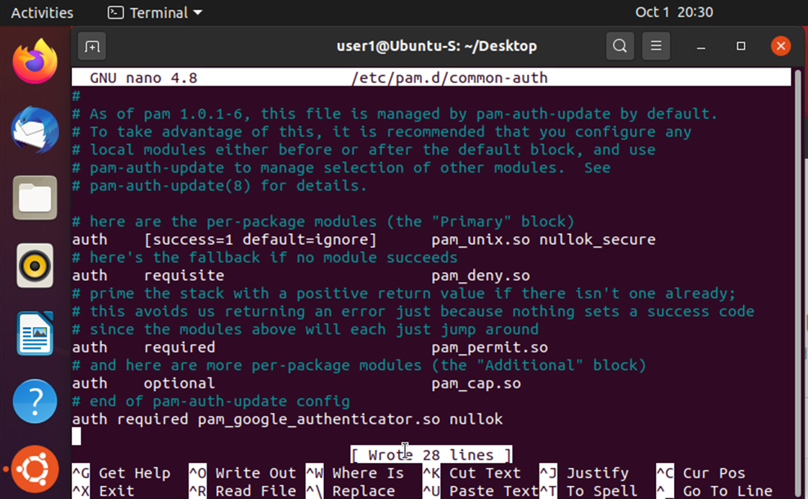
Google common auth file loaded
This shows that authentication through googles common auth app is required for users to sign in.

Slide 23
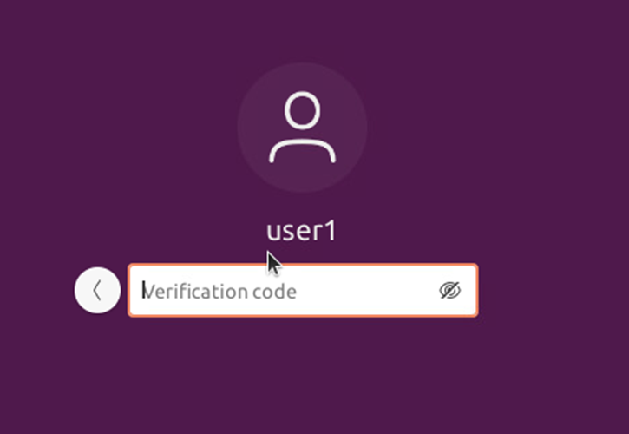
Multi factor authentication login screen
Before a user can sign in they must present a correct password and authenticate using the google authenticating app and present the correct verification code that is displayed in that app.

Slide 24
Module 5 summary
Using all of these tools (encryption, firewalls, security policies’, and MFA) are great but sometimes vulnerabilities can be missed.
The final module will demonstrate how to use Assessment applications that will scan the network and bring potential vulnerabilities to the attention of system administrators.

Slide 25
SEC285
Module 6
Vulnerability Assessment
Student: Taylor Muse
Session: 10400

Slide 26
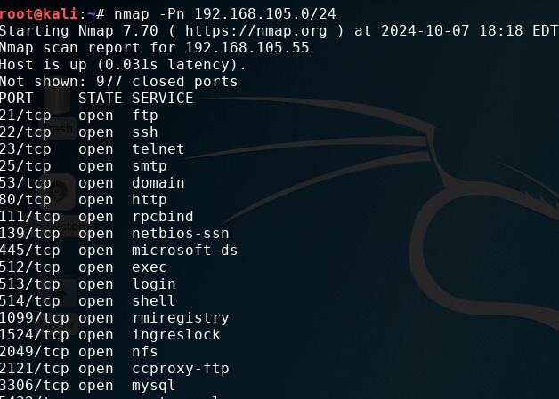
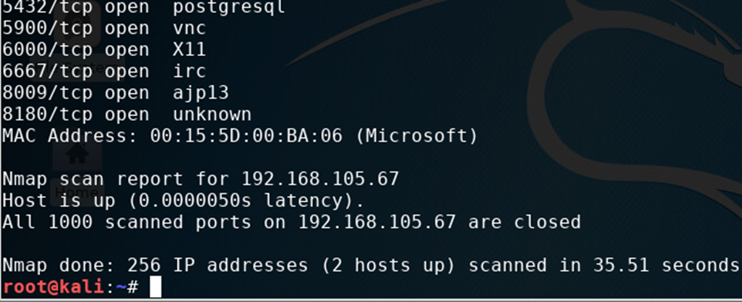
Nmap scan
Nmap is used to determine open ports and active hosts for preventing infiltration into the network. Having unnecessary ports open or hosts active that aren’t being used is like leaving doors open to your house.

Slide 27
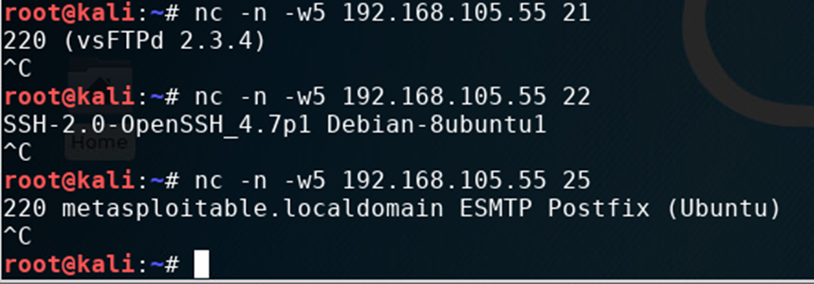
netcat
Demonstrating NetCat’s ability to view the current software information that a host is using. This information can be useful to potential hackers for finding vulnerabilities in the operating system.

Slide 28
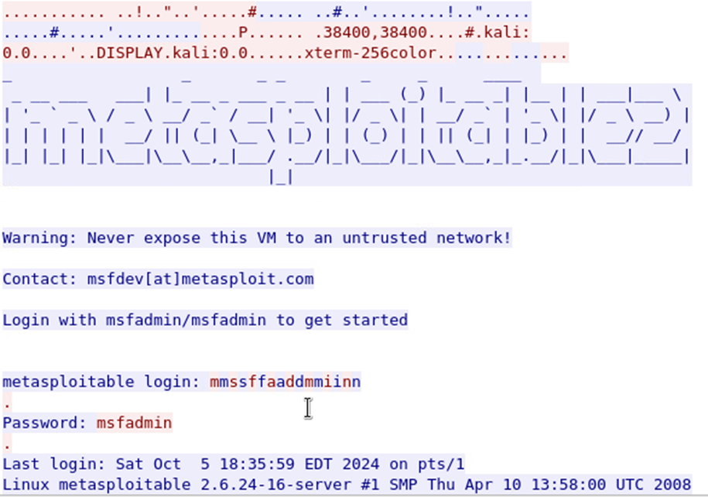
Wireshark demonstration
This screenshot shows what information is shown when using a Wireshark telnet command and a user enters their username and password

Slide 29
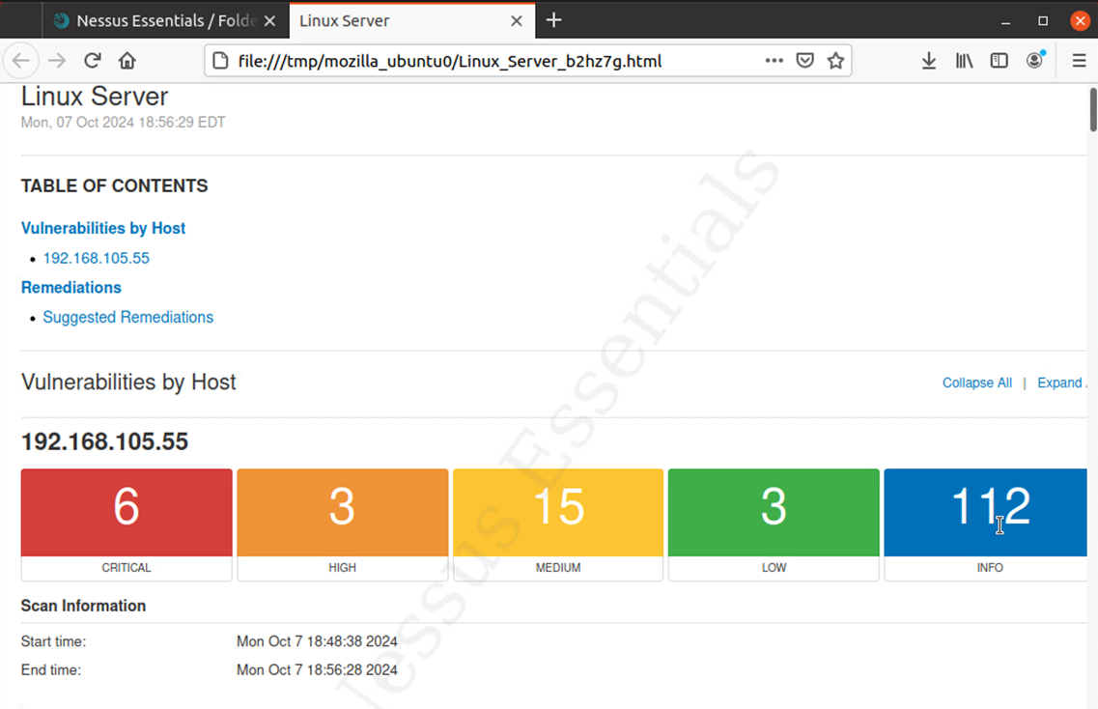
Nessus vulnerability assessment
Nessus is used to scan your system to determine security threats active on your system. As this screenshot shows our server has several security weaknesses that should be addressed and mitigated.

Slide 30
Module 6 summary
Nessus is an amazing application that can do the work of a dozen IT experts at finding vulnerabilities and set the stage for system administrators to isolate threats and reduce the risk of spillage infiltration.

Slide 31
Career skills
Linux proficiency
Firewall implementation
MFA on Linux
GPG encryption
Nessus scans
Wireshark

Slide 32
References
Ciampa, M. (2017). Security+ Guide to Network Security Fundamental (Sixth ed.). Boston, MA: Cengage Learning.

Slide 33
Conclusion
In this project I was able to bring all of the tools and fundamentals learned over the last eight weeks and apply them to identify and minimize security risks on a Linux machine. From applying firewall configuration using the IPtables commands, to ensuring MFA is required for logging in as users, and running Nessus scans I now feel I can appropriately secure a Linux machine and use software to my advantage to prevent unauthorized access to the files and system settings.

Slide 34
Wix website link

Slide 35
THANK YOU
Taylor Muse​
Taylormuse03@gmail.com

