Slide 1
NETW191 Final Course Project
Author: Taylor Muse
Devry University

Slide 2
INTRODUCTION
This project will demonstrate my ability to configure a Small Office-Home Office network to include
  IPv4 addressing
  Connectivity testing
  Subnetting and loopback interfaces
  Creating a network diagram on Visio
  SOHO wireless network security

Slide 3
NETW191 Course Project
Module 2
IPv4 Addressing

Slide 4
Introduction
In this project I will demonstrate how to implement an IPV4 addressing scheme to support network activities.

Slide 5
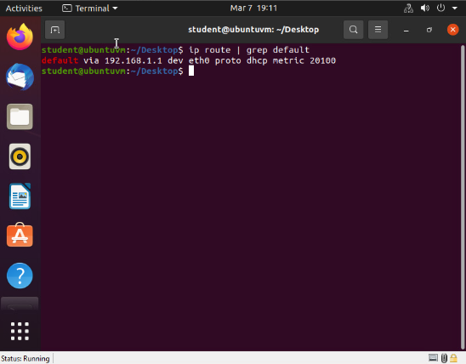
Preparation
This screenshot should include the terminal window that shows the default gateway IP address.
This screenshot should also show the date/time information on top of the Terminal window.

Slide 6
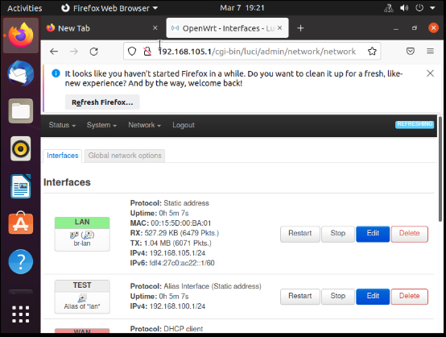
IPv4 Address Assignment
This screenshot should include the Interfaces page that shows the new IPv4 address on the LAN interface.
This screenshot should also show the date/time information next to the Firefox Web Browser tab.

Slide 7
Conclusions
- In this project I changed the default IPV4 address of the SOHO router using the interface GUI using Firefox and the IP address to connect
- Verified the new IP address using command prompt on Linux machine and by entering new IP address into the browser URL bar and connecting to the interface tab.

Slide 8
NETW191 Course Project
Module 3
Connectivity Test

Slide 9
Introduction
In this project I will demonstrate that the IP address for the SOHO router was changed, and that “Computer 1” and “Computer 2” IP addresses have updated.

Slide 10
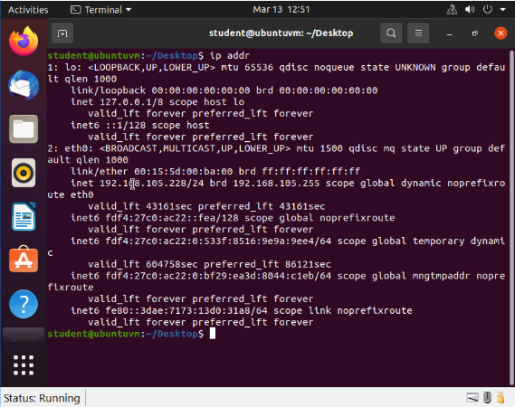
Dynamic IP Address Assignment
Take a screenshot of the Terminal window.
This screenshot should show the IPv4 address of the Computer 1 VM.
This screenshot should also show the date/time information on top of the Terminal window.

Slide 11
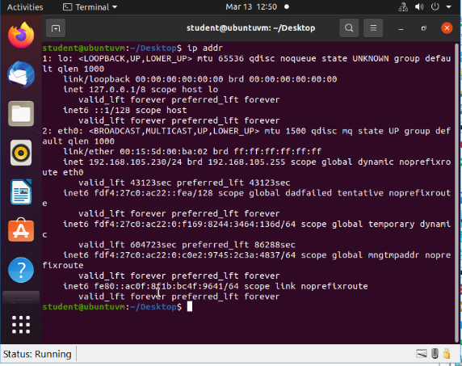
Dynamic IP Address Assignment
Take a screenshot of the Terminal window.
This screenshot should show the IPv4 address of the Computer 2 VM.
This screenshot should also show the date/time information on top of the Terminal window.

Slide 12
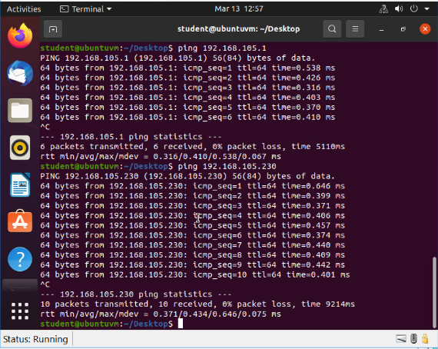
Connectivity Test
Take a screenshot of the Terminal window.
This screenshot should show 1) the connectivity test FROM the Computer 1 VM TO the SOHO Router VM, and 2) the connectivity test FROM the Computer 1 VM TO the Computer 2 VM.
This screenshot should also show the date/time information on top of the Terminal window.

Slide 13
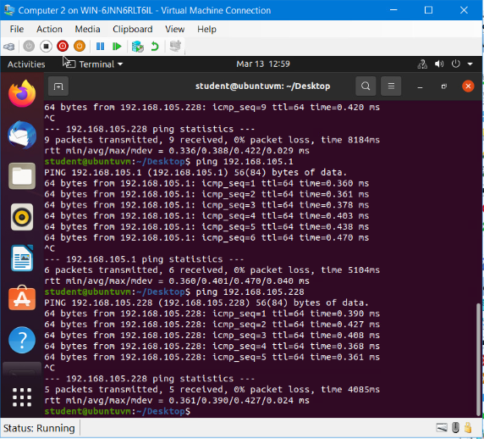
Connectivity Test
Take a screenshot of the Terminal window.
This screenshot should show 1) the connectivity test FROM the Computer 2 VM TO the SOHO Router VM, and 2) the connectivity test FROM the Computer 2 VM TO the Computer 1 VM.
This screenshot should also show the date/time information on top of the Terminal window.

Slide 14
Conclusions
In this project I,
Verified the new IP addresses for the SOHO router, Computer 1 and Computer 2 using the “ip addr” command.
Verified connectivity of all devices by using “ping” command from both “Computer 1” and “Computer 2”.

Slide 15
NETW191 Course Project
Module 4
IP Subnetting and Loopback Interfaces

Slide 16
Introduction
In this project I will demonstrate dividing one network into two subnets, creating loopback interfaces from the router to the computers and verifying connectivity.

Slide 17
IP Subnetting
Subnet ID | Network Mask (/prefix) | Network Mask (Dotted decimal) | Network Address | First Usable Host Address | Last Usable Host Address | Broadcast Address
0 | /25 | 255.255.255.128 | 192.168.5.0 | 192.168.5.1 | 192.168.5.126 | 192.168.5.127
1 | /25 | 255.255.255.128 | 192.168.5.128 | 192.168.5.129 | 192.168.5.254 | 192.168.5.255
This table should include two /25 subnets, listing
Subnet notation
Network address
First usable host address
Last usable host address
Broadcast address

Slide 18
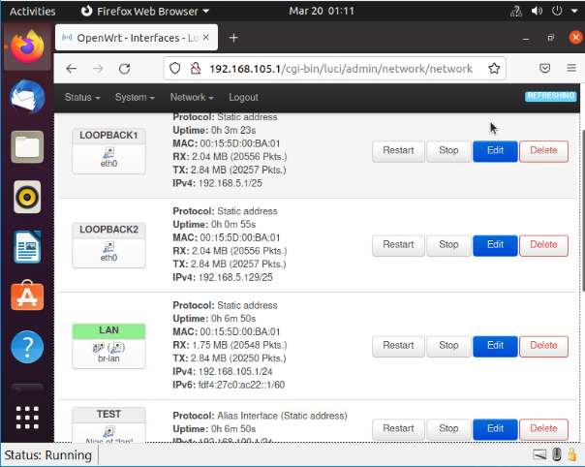
Loopback Interfaces
This screenshot should show both Loopback1 and Loopback2 interfaces and their correct IPv4 addresses.
This screenshot should also show the date/time information on top of the desktop window.

Slide 19
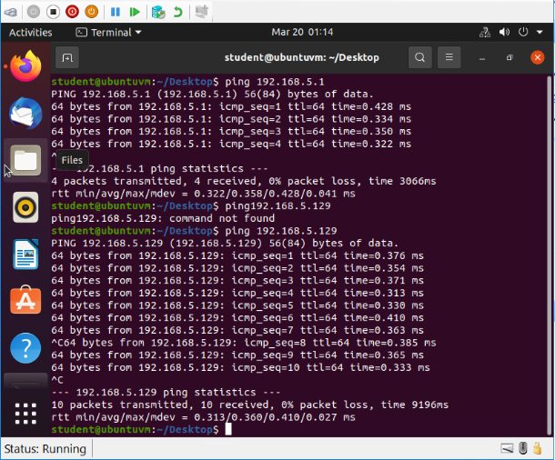
Connectivity Tests
This screenshot should show two successful ping tests:
from the Computer 1 VM to the Loopback 1 interface
from the Computer 1 VM to the Loopback 2 interface
This screenshot should also show the date/time information on top of the desktop window.

Slide 20
Conclusions
I learned how to divide a network into subnets and calculate network addresses based on the size of the network and the amount of hosts available.
How to create a virtual loopback interface on the router using the first usable host IP address within each of the new subnets.
And how to verify that the newly created loopback interfaces are operating properly by ping’ing the entered IP address associated with the interface.

Slide 21
NETW191 Course Project
Module 5
Visio Network Diagram

Slide 22
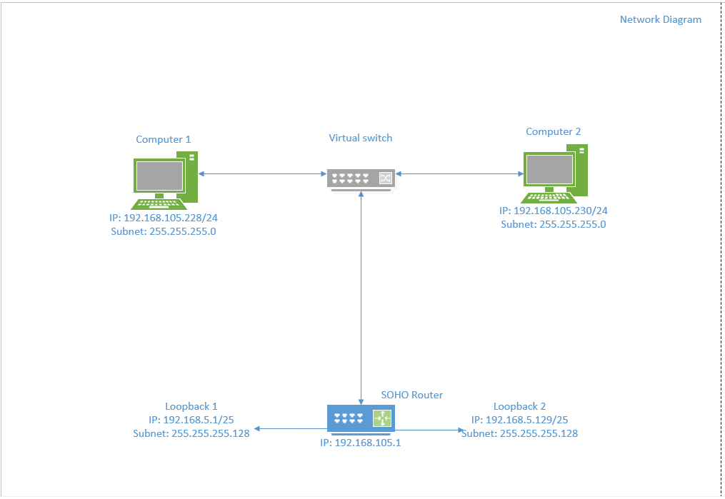
Microsoft Visio Network Diagram
This diagram should illustrate the interconnection of the Computer 1 VM, the Computer 2 VM, and the SOHO Router VM along with proper IP addresses and labeling.
This diagram should also show your initials in the bottom right corner.

Slide 23
Conclusions
In this project:
- I downloaded the Visio 2021 software
- Added the hardware that has been identified to the diagram.
- Created interconnections between the devices.
- Labeled all the devices with the IP address and subnet identifiers that has been established within the network.

Slide 24
NETW191 Course Project
Module 6
SOHO Wireless Network Security

Slide 25
Introduction
- I will explore the security fundamentals of a wireless SOHO router and answer 6 questions regarding the settings.

Slide 26
SOHO Wireless Network Security 1 of 3
1. What are the factory default username and password of a TP-Link router? Why is it important to change the default username and password of a SOHO router?
Answer: Username: admin Password: admin. Its important to change the default username and password because anyone with any knowledge of routers could easily guess the combination. If an automatic hacking device was trying to infiltrate the router it would be very easy to guess the same string of characters for the username and password. Also, with a simple google search anyone could locate the factory username and password and could edit the routing configuration and disrupt how information Is flowing through the network.
2. To protect a SOHO wireless network with a small number of devices, which address management method provides more control, configuring the device IP addresses manually (static IP) or using a DHCP server (dynamic IP)? Why?
Answer: The most control of the network would be by using the DHCP address management method so that the IP address is constantly cycling through the selected IP addresses , which can be chosen by the administrator making it hard to pinpoint the IP address of the Host at any given time.

Slide 27
SOHO Wireless Network Security 2 of 3
3. What does MAC filtering do? If needed, when would you use deny filtering rules and when would you use allow filtering rules? What happens to devices that want to connect, if the “Allow the stations specified by any enabled entries in the list to access” function is enabled but there are no entries in the list?
Answer: Wireless MAC filtering will prevent wireless devices from accessing the WiFi router unless they are authorized to be on the network. Allow filtering would only allow the devices that you add to the filter to obtain access to the router so that you can keep the accessible devices to a known number of machines. Deny filtering will allow all machines access except for the specified machines listed. If no machines are entered and the allow filtering is on, then no machines would have access to the network.
4. What wireless security settings are displayed on the Wireless Security page? Which one is recommended by the vendor? Why?
Answer: The options displayed on the wireless security page are Disable wireless security, WPA/WPA2-Personal, WPA/WPA2- enterprise, and WEP. WAP/WAP2- personal is recommended by the vendor because It has the best security features and encryption protocols for small home and home office networks for preventing decryption of the network.

Slide 28
SOHO Wireless Network Security 3 of 3
5. Among the configurations you explored in this module, which one is a true security function? Why?
Answer: All of the configurations play a part in the grand scheme of security. Although the Wireless security settings are the most important to prevent intrusion on the network, if you leave the default username and password active then anyone could disable your security settings.
6. What would you do to protect your wireless network at home? Why?
Answer: I have a TP-link router and the first thing I did was change the default username and password and ensured that the WPA/WPA2 –Personal security encryption setting were enabled.

Slide 29
Conclusions
- I explored the security settings of a TP-link SoHo router and studied the applicable settings and the benefit of each option.

Slide 30
CHALLENGES OVERCOME
Over the duration of this course I learned several new skills and throughout the course I faced challenges including:
  Changing IP addresses through the network GUI
  Learning how to create a diagram on Visio
  Understanding subnetting tables and the math behind it
  And learning the differences between the wireless network security settings

Slide 31
CAREER SKILLS
WRITING SKILLS
EXPERIENCE WITH MICROSOFT AZURE
EXPERIENCE WITH CISCO ROUTERS
CONFIGURING NETWORK IP ADDRESSES
SUBNETTING A NETWORK

Slide 32
COURSE CONCLUSION
- Overall, I learned a lot about configuring networks that I had not seen from experience.
In my experience prior to this class I had troubleshot on networks like the one we configured, but I had mostly just performed connectivity tests and remote host logins to confirm that hosts were active and running properly
Now I feel very confident in my ability to configure a new network from the ground-up to meet or exceed the standard required for the desired use.

Slide 33
References
- West, J. (2021). CompTIA Network+ Guide to Networks (Ninth ed.). Boston, Massachusetts: Cengage Learning.

