Slide 1
Building a Home Security System
CEIS101 Final Course Project
Session: January 2024 10197
Taylor Muse
Prof. Darniet Jenkins

Slide 2
Introduction
This project will include week 2-6 projects of assembling a home security system on an Arduino mega board and using tinkercad to design the system.
Included in the security system was a door distance sensor, an open-close sensor, a light sensor, an alarm, and various LEDs to indicate different states of the system.
Tools used in this project: Arduino IDE software, TINKERCAD software, Arduino mega board controller, 1 breadboard, various wires, 1 photoresistor, 1 10k resistor, 1 active buzzer, 1 green, 1 red, 1 yellow, and 1 blue LED, and 1 ultra sonic range finder.

Slide 3
CEIS101
Module 2
- Circuit Simulation in Tinkercad

Slide 4
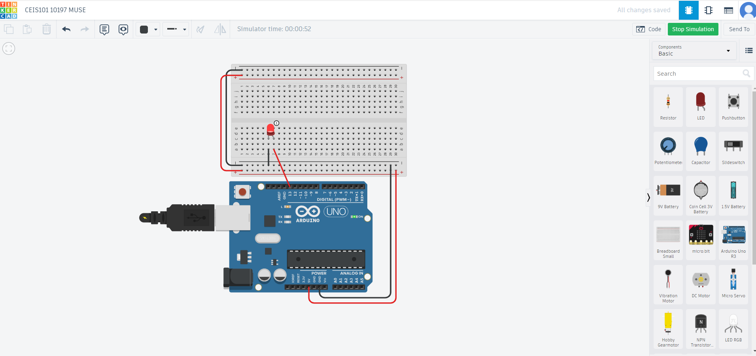
Circuit in TINKERCAD

Slide 5
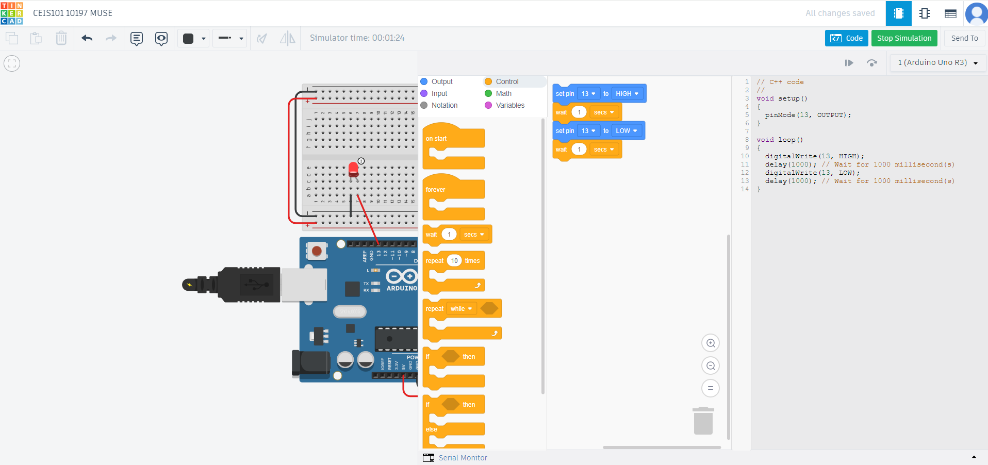
Code in TINKERCAD

Slide 6
Module 2 summary
- In module 2 I designed a simple on-off led in TINKERCAD and showed the code required to turn the LED on and off.

Slide 7
CEIS101
Module 3
Inventory of Parts, Circuit Building, and Displaying Messages

Slide 8
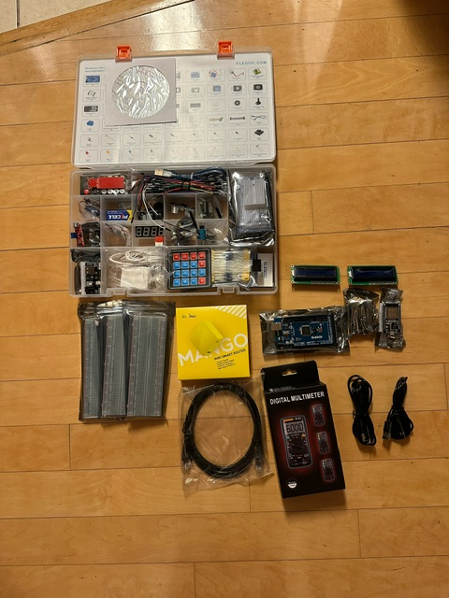
Inventory of IoT Kit (picture)
UCTRONICS Kit
ESP32 (2)
LCD Modules (2)
Breadboards (3)
Mini Router
Patch Cable
Digital Multi Meter
USB to Micro USB (2)

Slide 9
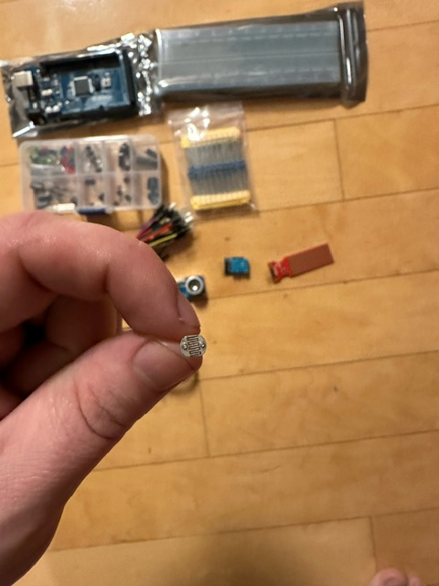
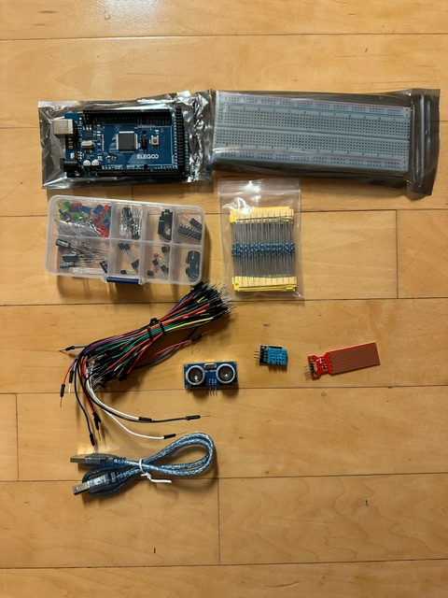
Organization of Project Components (picture)
Arduino Mega 2560
Breadboard
Resistor 10kΩ
LEDs
Ultrasonic Sensor
Active Buzzer
Photoresistor
Wires
USB Type B cable

Slide 10
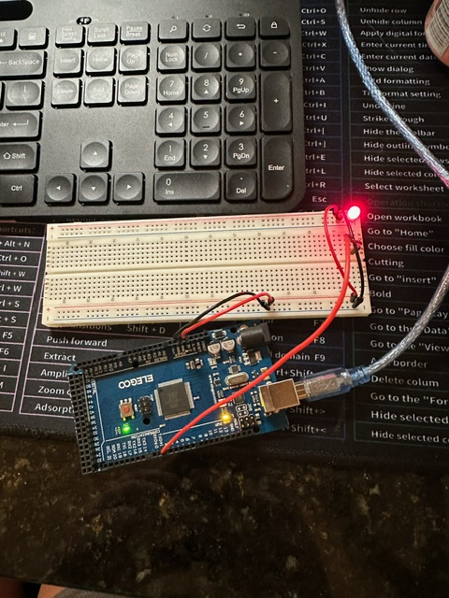
Circuit with red LED on (picture)

Slide 11
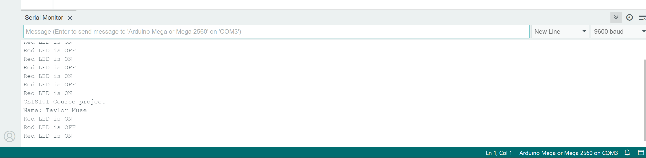
Serial Monitor (screenshot)

Slide 12
Module 3 summary
In module 3 I took an inventory of all the parts needed for the project.
I used the design developed in module 2 on the mega board to show the red LED on.

Slide 13
CEIS101
Module 4
Adding Door Sensor to Smart Home System

Slide 14
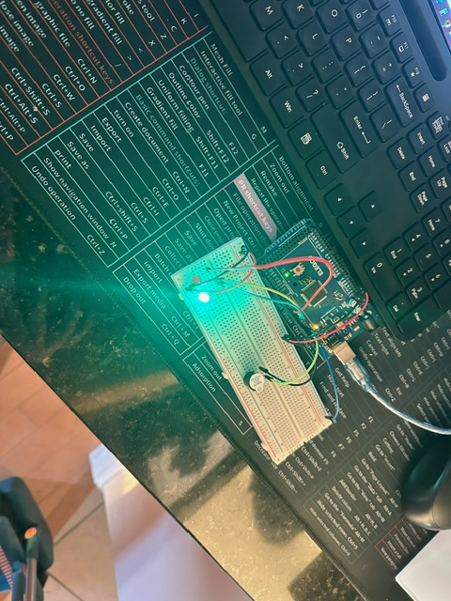
Circuit of door closed with Green LED ON

Slide 15
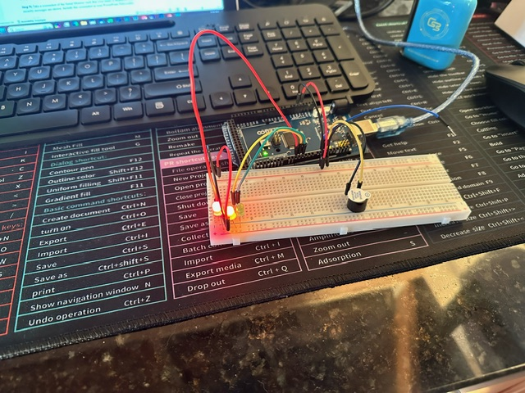
Circuit of door open with Green LED OFF (picture)

Slide 16
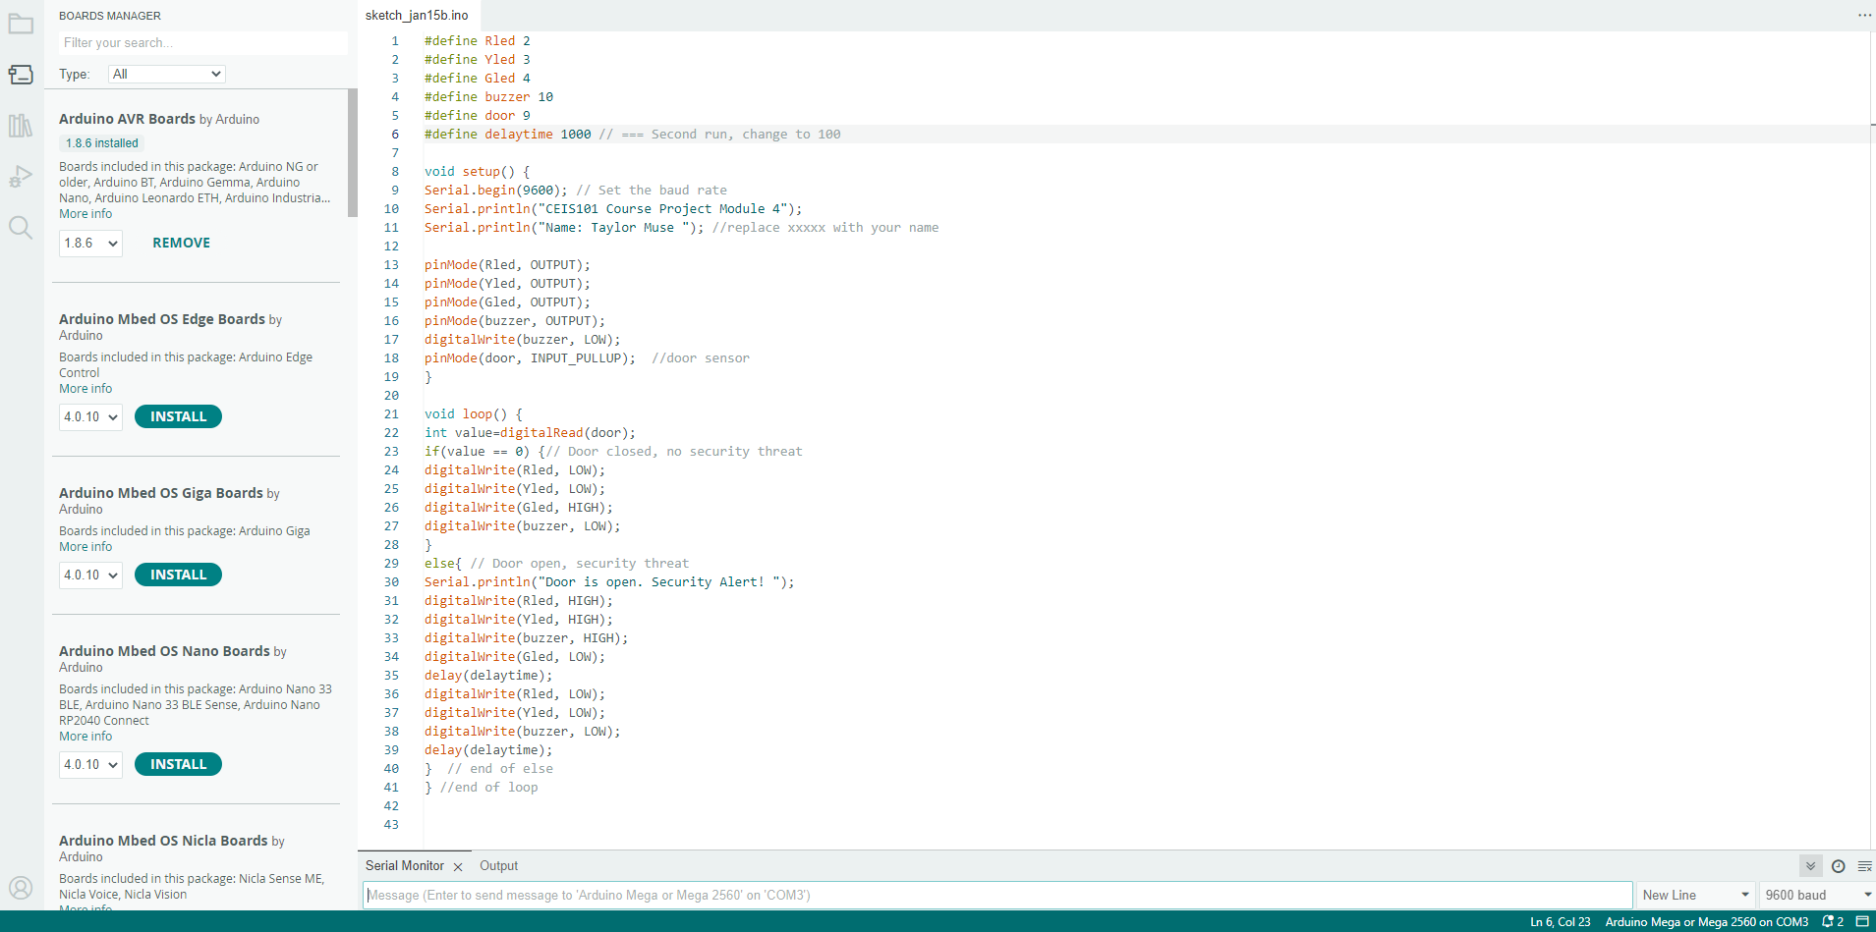
Arduino Code (screenshot)

Slide 17
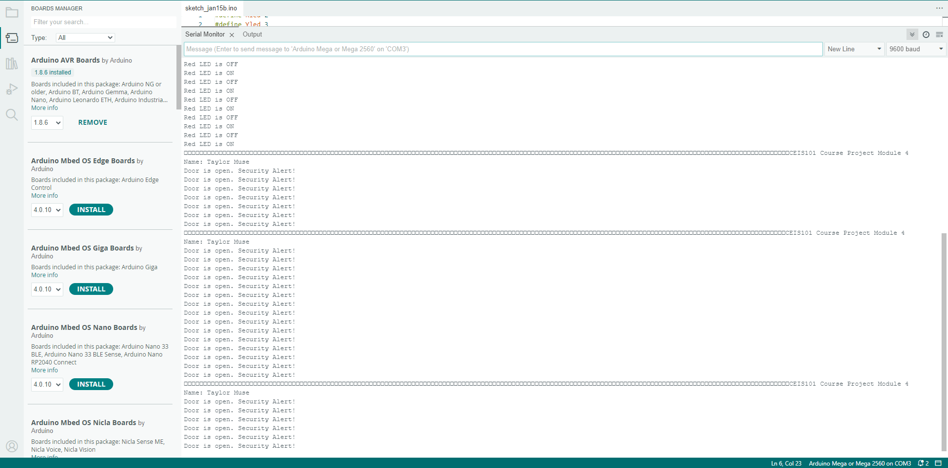
Serial Monitor (screenshot)

Slide 18
Module 4 summary
Installed a green and yellow LED.
Installed active buzzer.
Used a blue wire to simulate the door opening and closing to show the led is green when the door is closed and the red and yellow LEDs flashing when the door is open,

Slide 19
CEIS101
Module 5
Adding Distance Sensor to Smart Home System
and Conducting Data Analysis

Slide 20
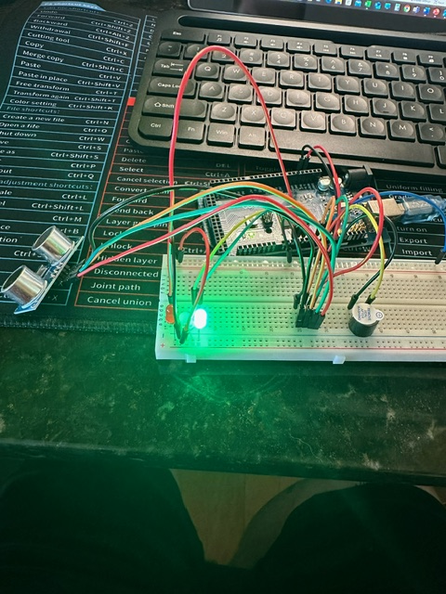
Circuit with green LED on (picture)

Slide 21
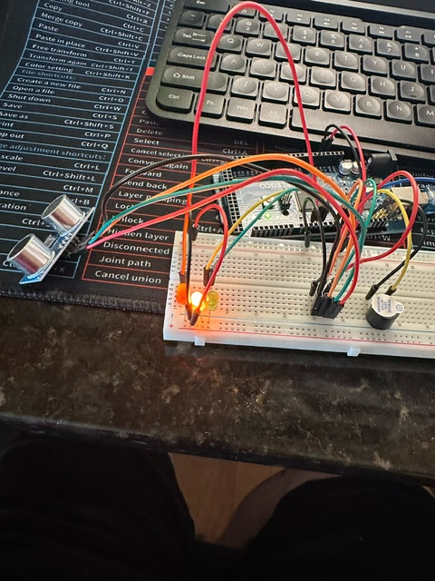
Circuit with yellow LED on (picture)

Slide 22
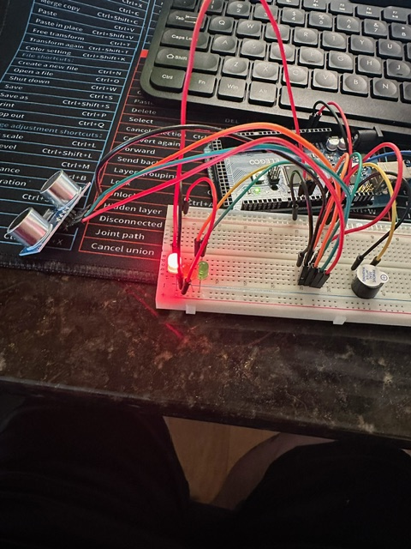
Circuit with red LED on (picture)

Slide 23
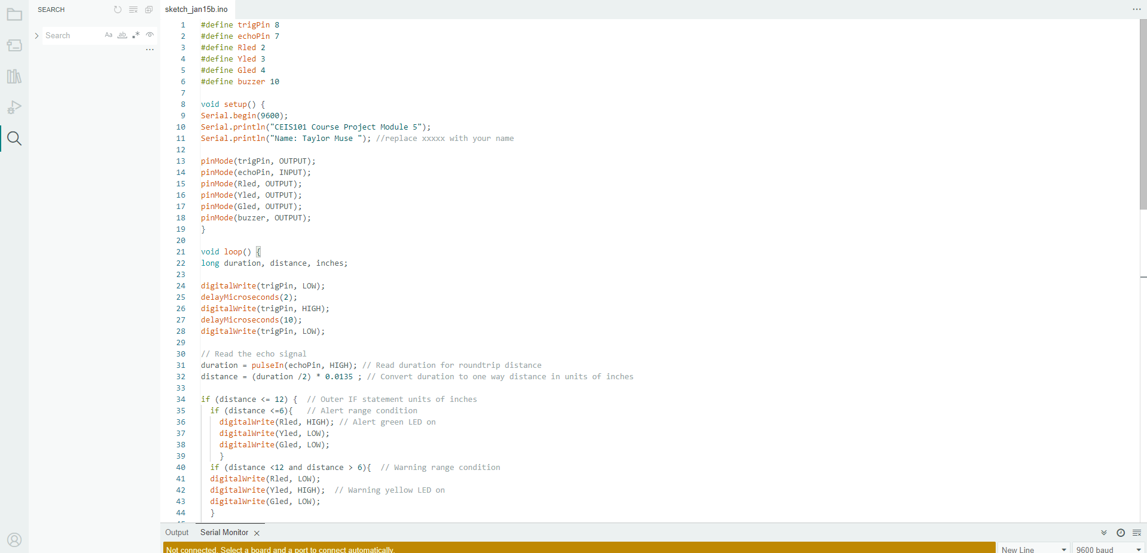
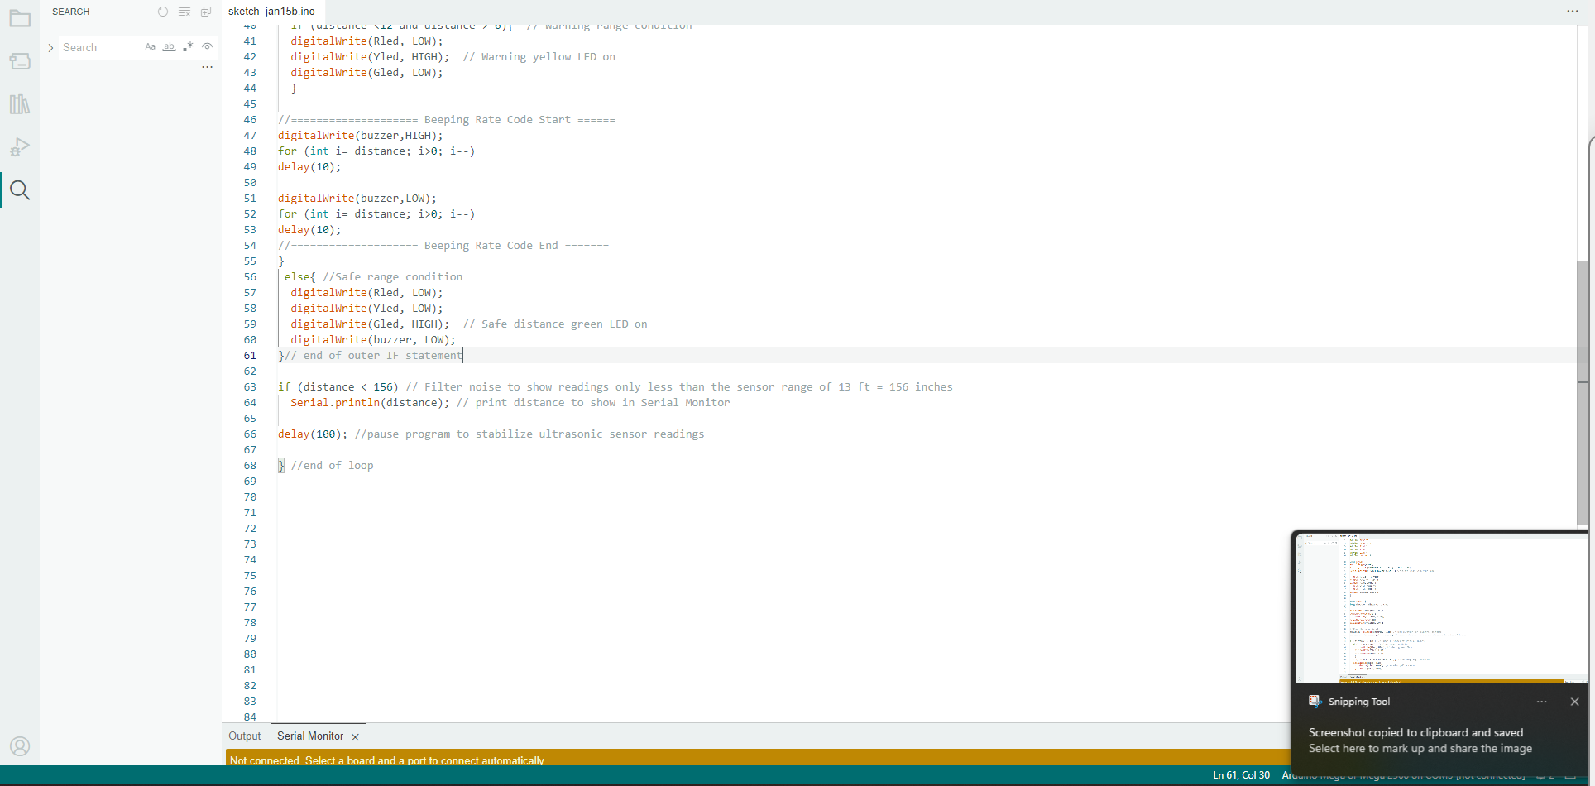
Arduino Code (screenshot)

Slide 24
Plot of data (graph from Excel)

Slide 25
Module 5 summary
Installed ultrasonic range finder
Wrote code in Arduino to signify how close the door is to the sensor and show different leds based on the distance

Slide 26
CEIS101
Module 6
Adding Automated Light to Smart Home System

Slide 27
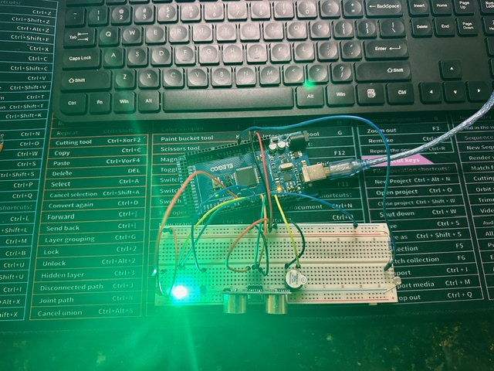
Circuit with automated LED off (picture)

Slide 28
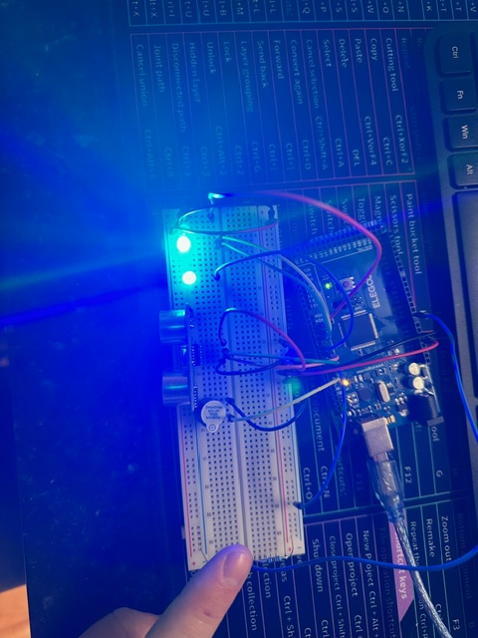
Circuit with automated LED on (picture)

Slide 29
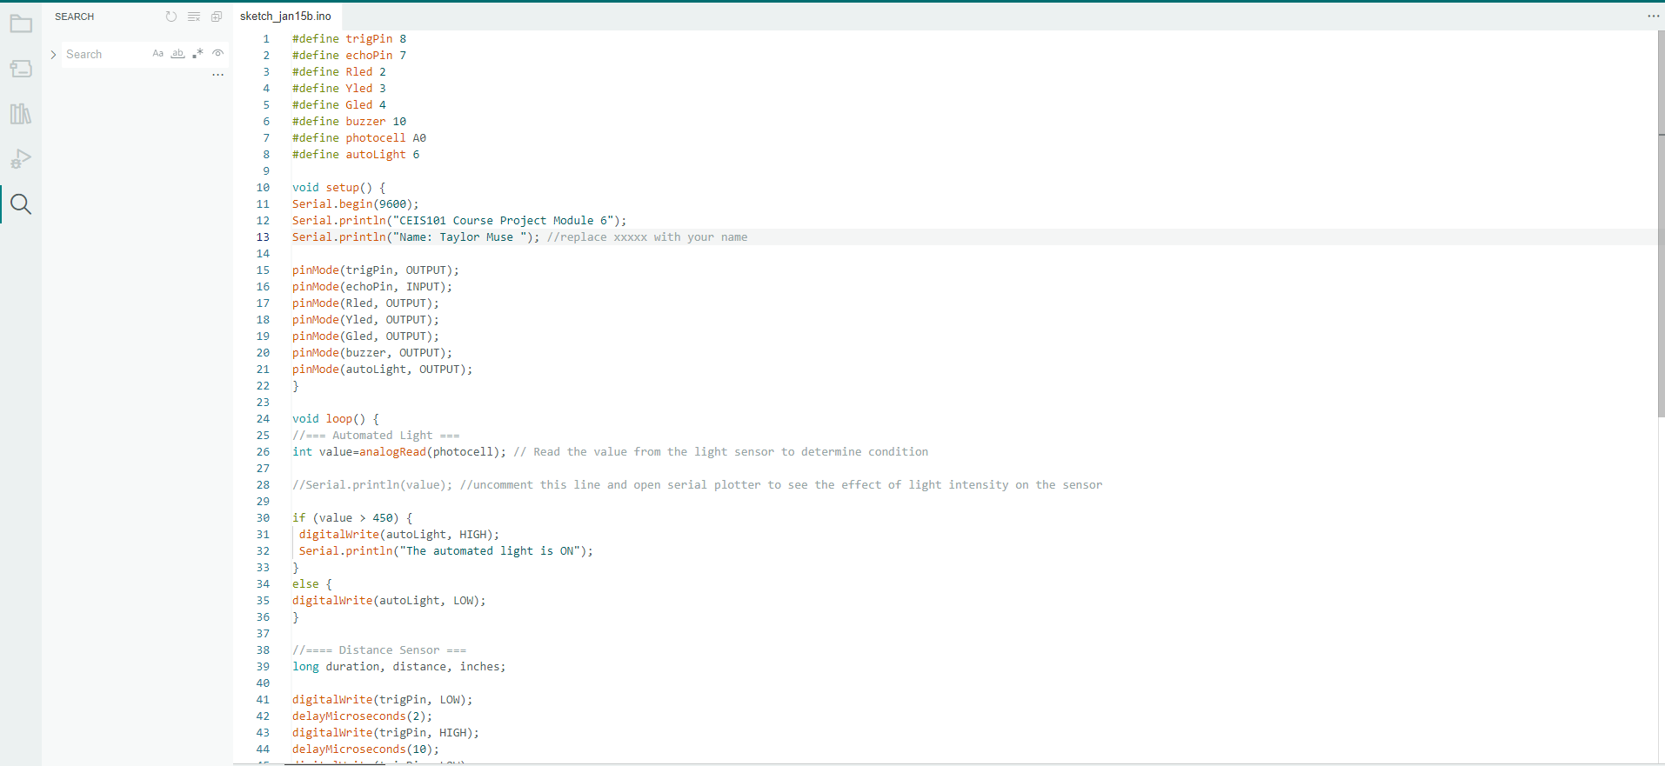
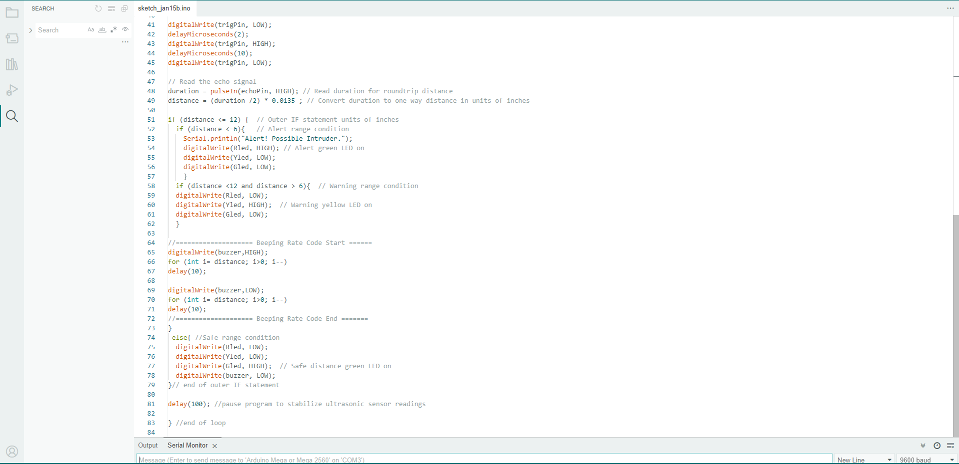
Arduino Code (screenshot)

Slide 30
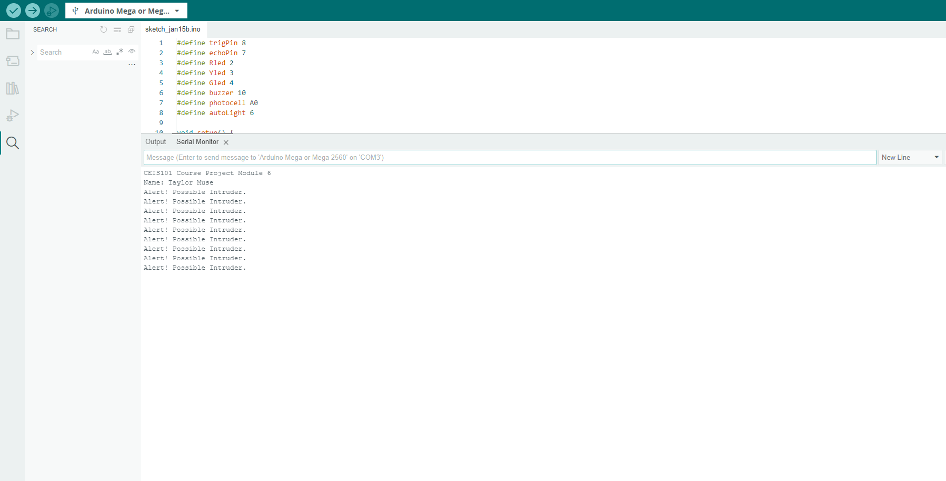
Serial Monitor (screenshot)

Slide 31
Module 6 Summary
Installed photoresistor, 10k resistor and blue led.
Wrote code to turn on led when photoresistor is absent of light.

Slide 32
Challenges/Lessons Learned
Challenges:
- cable management
- using TINKERCAD and Arduino for the first time
- I could not get the water level sensor to work properly for the challenge activity
Lessons learned:
-follow the project guide and don’t be afraid to ask the professor for clarification in the homework huddle or during seminars

Slide 33
Career Skills
Cable management
Arduino coding
TINKERCAD design

Slide 34
Conclusion
- I gained a mass of knowledge on basic design and circuit building principles
- Before this class I had never used the Arduino software or TINKERCAD software and now I feel comfortable using this software in the future for designing and building IOT devices.

Slide 35
References
- Module 2-6 project guides and videos

