Slide 1

CEIS110 INTRO TO PROGRAMMING FINAL PROJECT
Author: Taylor muse

Slide 2
introduction
In this course I will demonstrate my ability to use Python programming language to do the following:
- Create a flow chart showing the design of the code I will create and what will be accomplished
- download the weather data for my zipcode and save to an external Database file
- Query the database file to find the highest and lowest temperatures and all clear days
- Converted the database file type to an Excel file and created line charts to visually demonstrate the relations between the temperature and humidity in Excel.
- Used Pandas matplot lib code to create graphical plots within the python code to demonstrate the relationship between temperature and humidity
- Analyzed the data and made predictions based on trends

Slide 3
Software utilization
Spyder Python programming tool
Microsoft office (Word, PowerPoint, Excel)

Slide 4
CEIS110
Module 2
Design and setup

Slide 5
Flowchart overview
To begin this project I first used a basic flowchart to categorize and prioritize my thoughts into sections so that the end goal can be met in a logical order

Slide 6
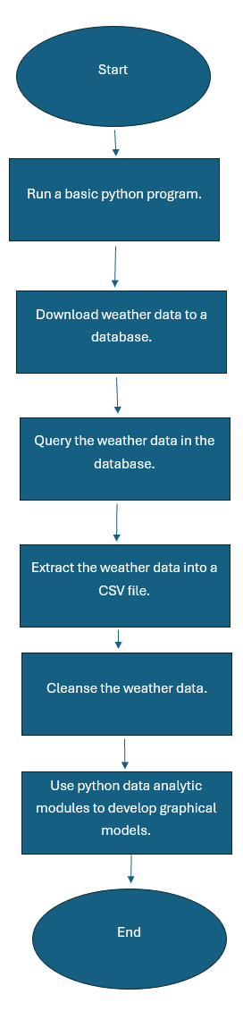
Flowchart
Include the following processes:
  Run a basic python program
  Download weather data to a database.
  Query the weather data
  Extract weather data from database into a comma separated file with python
  Cleanse weather data
  Use python data analytics modules to develop graphical models

Slide 7
CEIS110
Module 3
Downloading weather data

Slide 8
Extract weather data to a database file
- In the first step as identified in the flow chart I used a basic python program to download the weather data to a database file for use throughout the remainder of the project

Slide 9
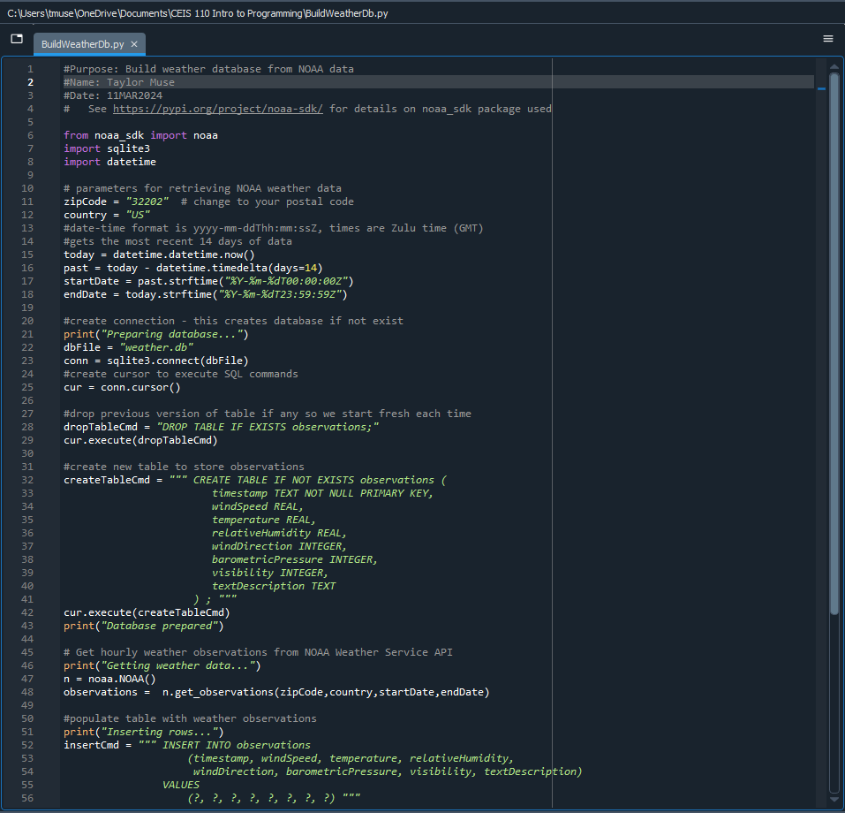
BuildWeatherDb.py Code
Screenshot of code in Spyder
Must have your name and date in comments
Must have your zip code

Slide 10
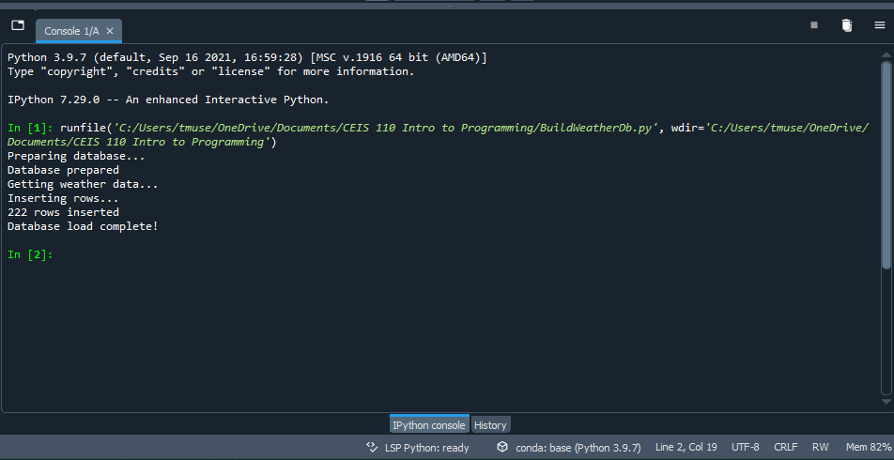
Python Console
Screenshot of program output in Python console showing program executed successfully

Slide 11
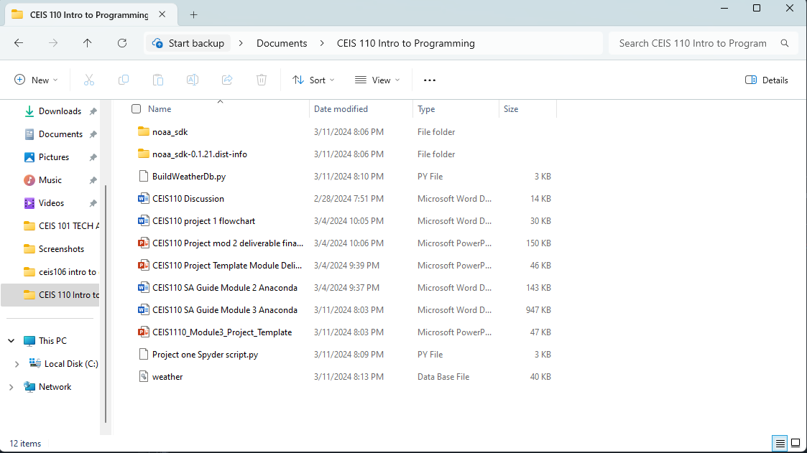
Weather.db File
Screenshot of Windows Explorer showing database file Weather.db was created

Slide 12
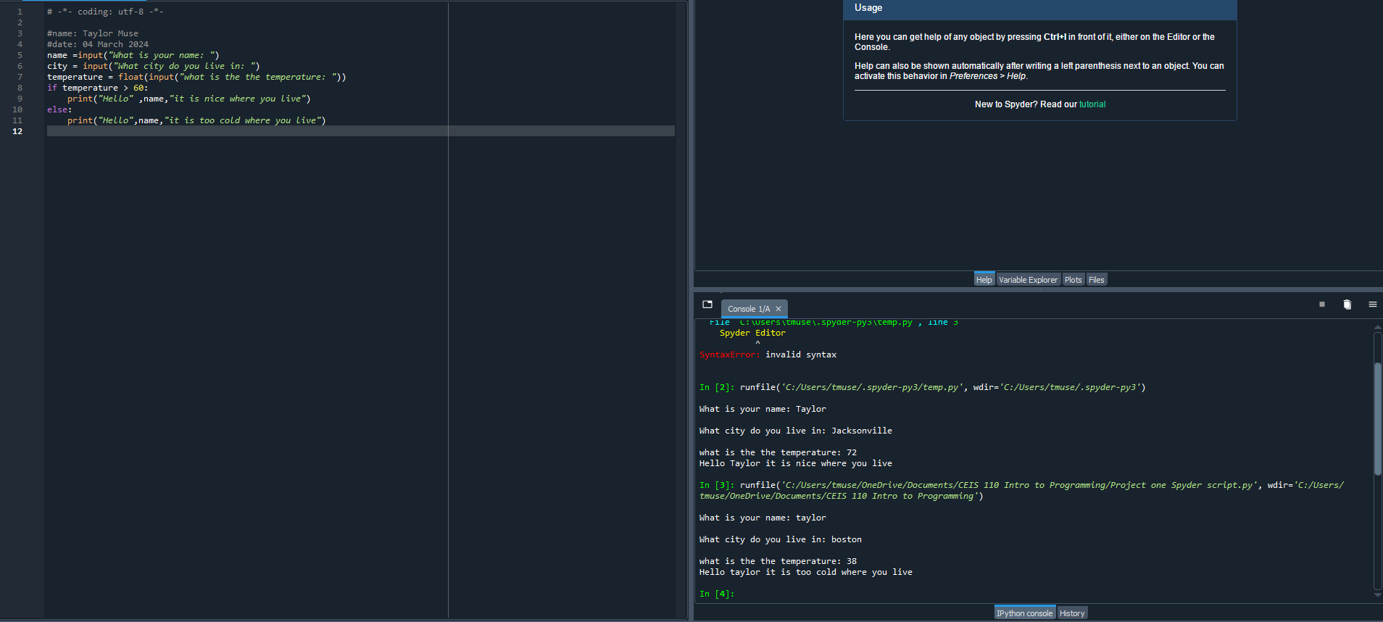
Python program
Include screenshot of successful python program

Slide 13
CEIS110
Module 4
Querying the database with SQL

Slide 14
Querying the database
Now that the database file has been downloaded the next step is to find the information needed to complete the project.

Slide 15
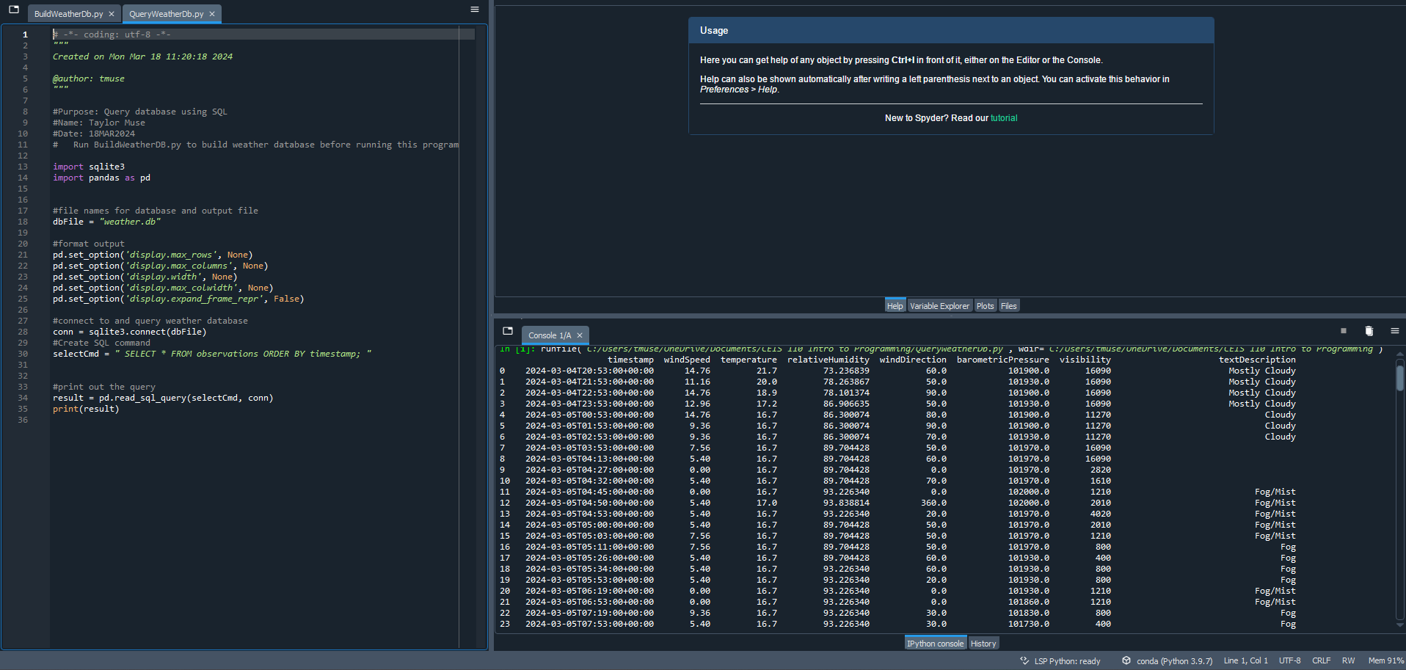
Query to retrieve all columns and all rows
Screenshot of SQL query command and results

Slide 16
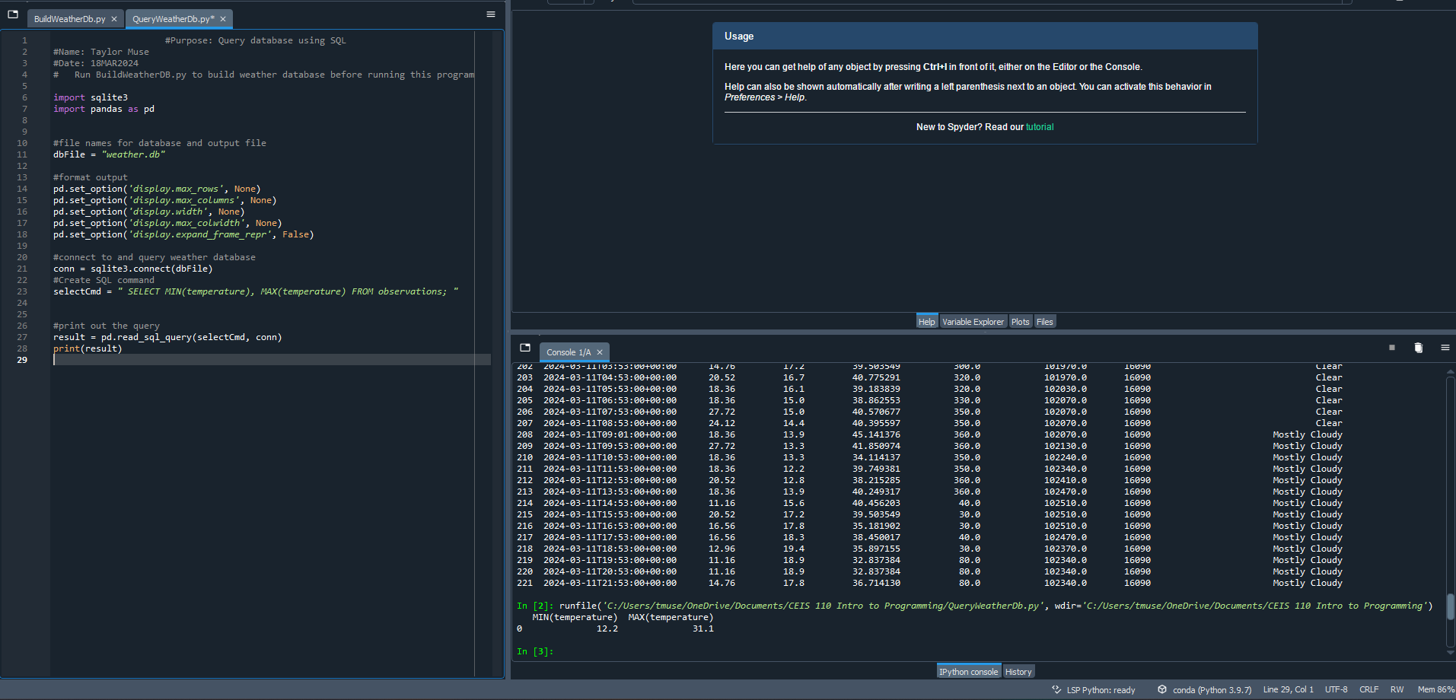
Query to retrieve lowest and highest temperatures
Screenshot of SQL query command and results

Slide 17
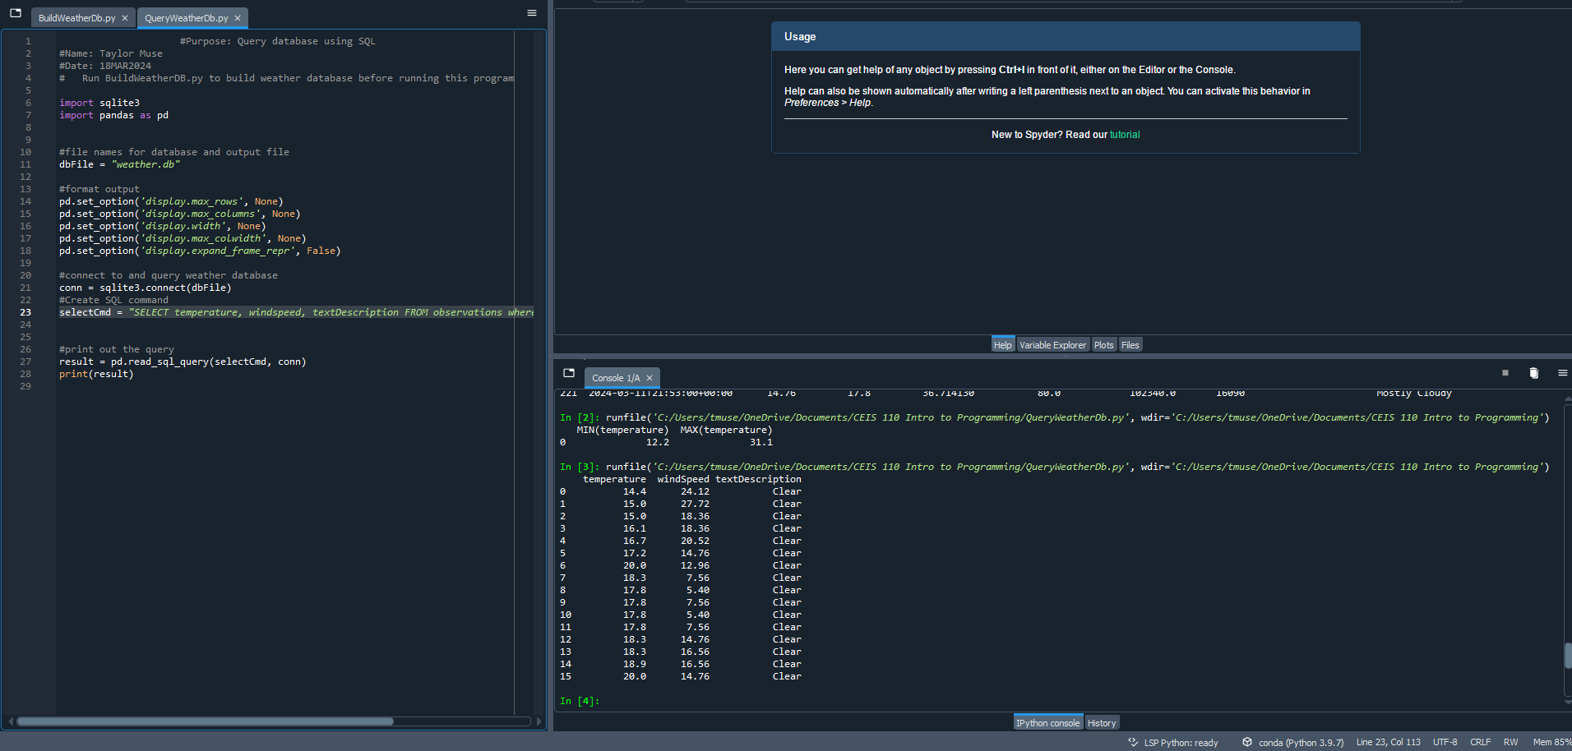
Query to retrieve all clear days
Screenshot of SQL query command and results

Slide 18
CEIS110
Module 5
Querying and manipulating data with SQL and Python

Slide 19
Extracting the data
Upon finding the data needed to demonstrate the correct outcome I cleansed the data of unwanted information and extracted the data to a CSV (excel) file created a line graph in excel.

Slide 20
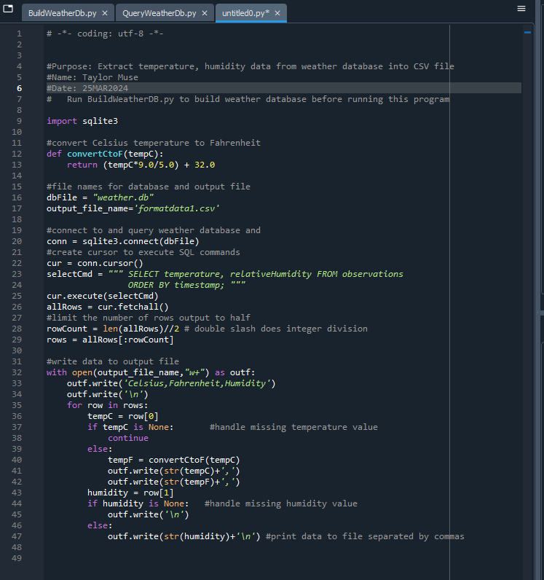
Python code
ExtractTempHumidity.py Python code with your name and date in comments

Slide 21
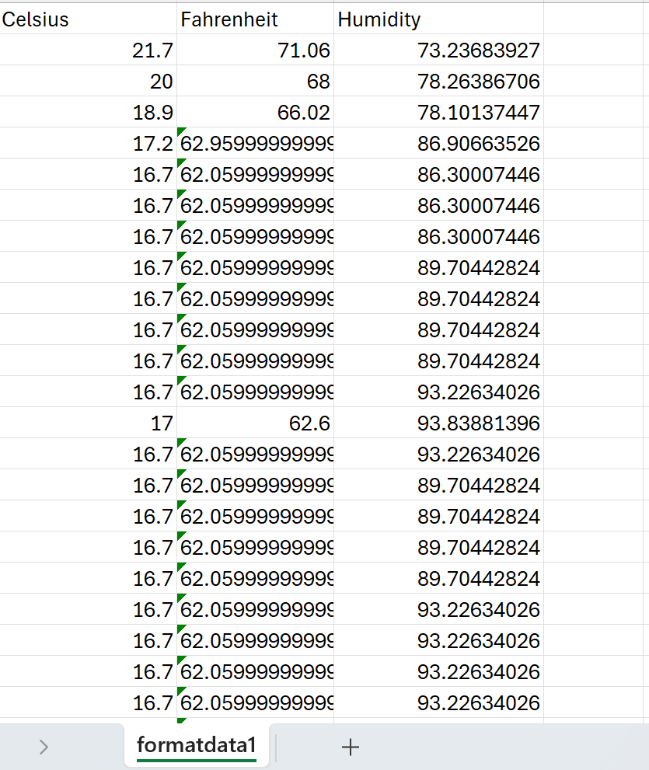
Retrieve and Convert Data to CSV Format
Formatdata file open in Excel showing 3 columns of data

Slide 22
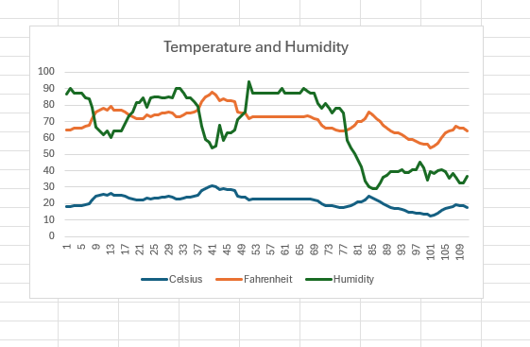
Temperature and Humidity Chart
(Graph)
Excel chart based on temperature and humidity data from database

Slide 23
CEIS110
Module 6
Develop Graphical Models and Interpret Results

Slide 24
Creating a Graphical plot within the python program
Using pandas to create a graph of the data without needing to extract to an excel file type and display it as a plot as an output of the code

Slide 25
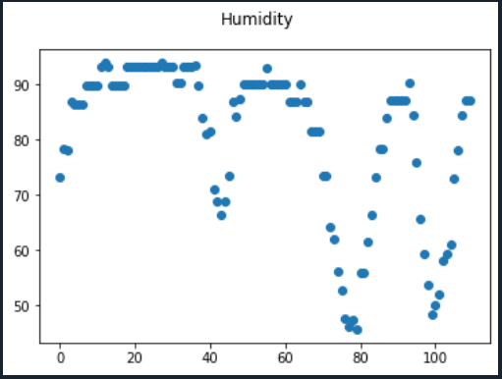
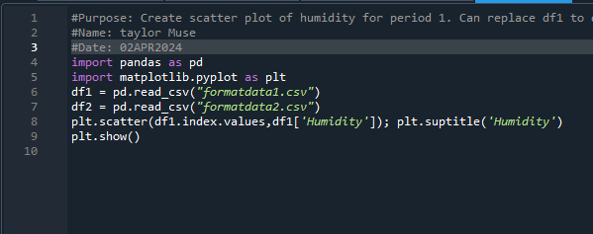
Scatter plot of humidity in week 1
Plot and code used to generate it
Box
Line
Histogram
Scatter
Research your own!

Slide 26
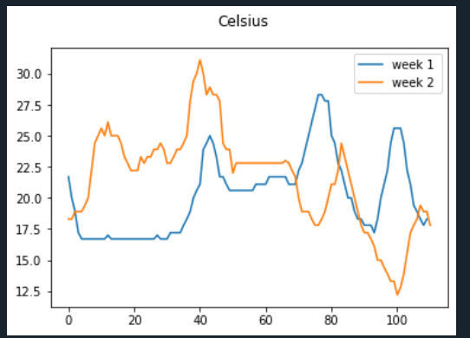
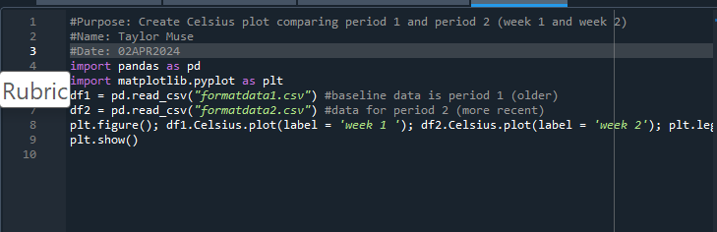
Line graph to show temperature change between the 2 weeks

Slide 27
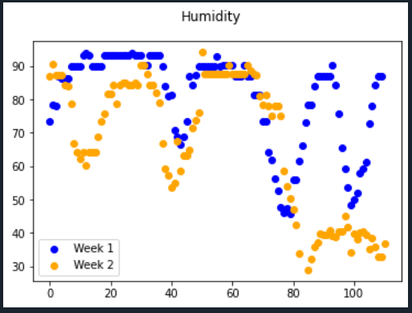
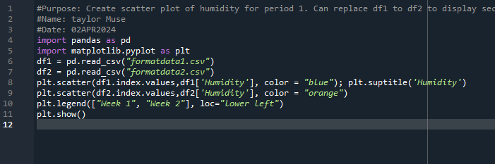
Analysis
How does the humidity in week 1 compare to week 2?
- In comparison week 2 had lower humidity, with humidity dipping to 30-40 percent at the end of the week.

Slide 28
Prediction
- Based on the data, the humidity decreases daily and returns to a higher state during the nighttime. With that in mind I predict the relativity between temperature and humidity to continue over the next days. I can also deduce that as the temperature climbs the humidity will decrease, which explains why the humidity drops daily.

Slide 29
conclusion
Throughout this course I used Python for the first time and learned a lot of key functions;
  I demonstrated my ability to plan out a project using Microsoft word to depict a flow chart of the steps needed to accomplish the goal
  How to download a database file of weather data
  Converted the data to an excel format and created line graphs in excel to depict the data
  Used pandas and matplotlib commands to create graphs within the python program to display the data for the user
  And I analyzed the data and made predictions based on previous days of data.

Slide 30
challenges overcome
Throughout this course every step demonstrated new knowledge gained and with that came challenges
As previously stated, this was my first time ever using the python language, I have used Linux in the past and some of that knowledge was certainly helpful.
Learning to use replit as well as Python to create code and find errors in my code
Very minor grammatical errors such as not using a space or semicolon in the write place would cause the code to not work properly

Slide 31
Career skills
  I now have the knowledge to create python code to achieve a multitude of functions
  I learned about if, while and for loops and how they relate to different functions and when they are best used
  I learned how to write the output of certain codes to write to a specific file for log-keeping
  I learned how to use Python to create a graph
  And overall, I feel I went from knowing nothing about python aside from it being a programming language, to now feeling like I could I create my own code for many different applications and uses
  This course overall has brought an entire new interest into my eyes, and I plan to use this more in the future for designing my own projects and devices to broaden my horizons.

Slide 32
references
- Miller, B. (2019). Programming in Python 3. Zyante Inc. (zyBooks.com).

Slide 33

Thank You
Author: taylor muse
taylormuse03@gmail.com

