Slide 1

Physics Final Project
Author: Taylor Muse
Devry University
TECH 204 Everyday Physics
Professor Karagiannes

Slide 2

AGENDA
INTRODUCTION
Inventory
Precision of Ultrasonic sensor
Acceleration of a free-falling object
Conservation of energy
Linear and rotational motion
Observing the hall effect
Challenges
Career skills

Slide 3

Introduction

Slide 4
This presentation will show the skills I developed during the TECH204 Everyday physics course. We used principles of physics to perform tests on a falling ball, calculating the accuracy and precision of multiple IoT sensors.

Slide 5
Inventory of Parts and Software

Slide 6
Ultrasonic Sensor HC-SR04
Describe the working principles of ultrasonic sensors in detail.
  Answer:
  The ultrasonic sensor produces sound waves from the trigger side of the transducer and listens for a return on the echo side. As the sound waves bounce off of an object and return to the transducer it generates an echo and by calculating the time it takes for a return of the signal the transducer can give an accurate distance that an object is from the sensor.

Slide 7
Rotary Encoder KY-040
Describe the working principles of rotary encoders in detail.
  Answer:
  The rotary encoder is used to generate an electronic signal based off of the rotational movement. This specific encoder will generate square wave pulses as the clock and data pins pass through an area in the disk that carries voltage or Vcc.

Slide 8
Hall Effect Sensor in ESP32
Describe the working principles of the Hall Effect Sensor in detail.
  Answer: The hall effect sensor is a device that measure the amount of magnetic field in the area. The higher the magnetic force the more voltage it will generate.

Slide 9
Screenshots
What tool will you used to take screenshots? How does it work?
  I will use the windows screenshot tool that is activated by pressing the print screen key on the keyboard and cropping the screen to capture the desired content.

Slide 10

Required Software
Screenshot of Microsoft Excel installed and running on your computer

Slide 11
Precision of the Ultrasonic Sensor

Slide 12
Data Collection
Trial | Ruler Distance (cm) | Total Roundtrip Distance (m) | Time from Serial Monitor (microseconds) | Roundtrip time (s) | Velocity = distance/time (m/s)
1 | 8 | 0.16 | 492 | .000492 | 325 m/s
2 | 10 | 0.2 | 586 | .000586 | 341 m/s
3 | 15 | 0.3 | 925 | .000925 | 324 m/s
4 | 20 | 0.4 | 1187 | .001187 | 337 m/s
5 | 30 | 0.6 | 1724 | .001724 | 348 m/s

Slide 13
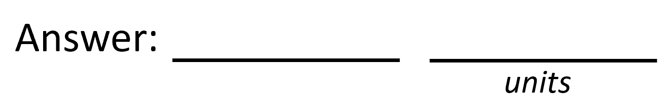

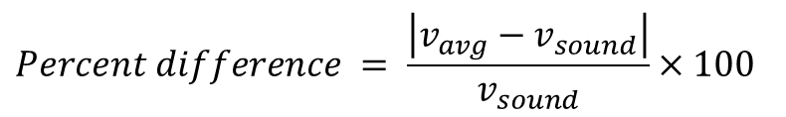

Data Analysis
Average velocity from table
Percent difference where $v_{sound}=343 m/s$
$$v_{avg}= \frac{v_{1}+v_{2}+v_{3}+v_{4}+v_{5}}{5}$$
335
m/s
$$Percent difference = \frac{\left|v_{avg}−v_{sound}\right|}{v_{sound}}×100$$
2.33
%

Slide 14
Conclusions
Briefly describe and explain the results.
  Answer: based on the baseline of speed of sound through air that is approximately 343 m/s the sensor shows a rate of error of 2.33% of the average speed of sound through air.
What is the dependence of temperature, humidity, and atmospheric pressure on the speed of sound? How does it affect the results?
  Answer: Temperature and humidity have the greatest effect on sound in this experiment, temperature will increase the speed at which sound travels through air conversely as well as higher humidities. If I were to perform this test outside of my house in Florida I would infer that the velocities would be higher due to sound propagation through air being increased from the temperature and humidity.

Slide 15
Gravitational Acceleration of a Free-Falling Object

Slide 16
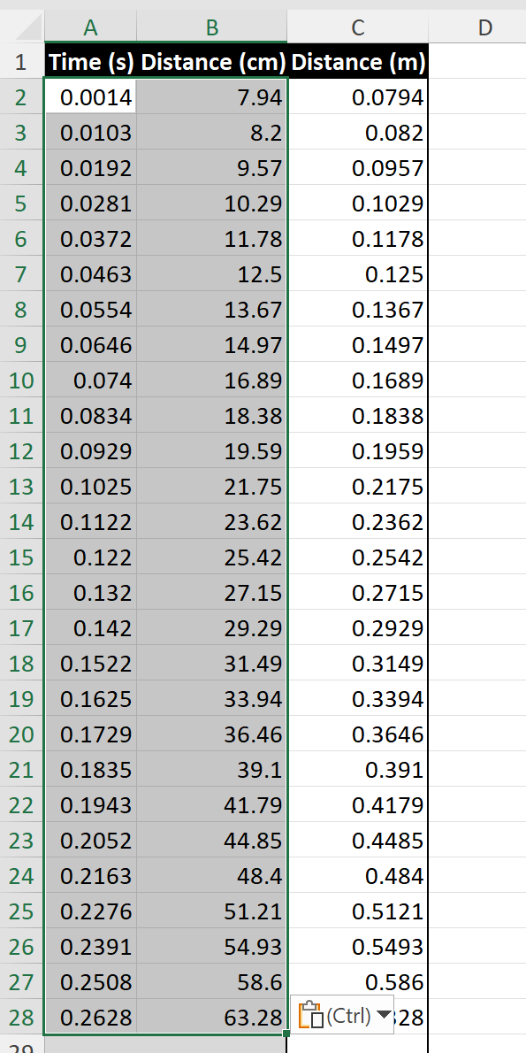
Excel Table
(Screenshot)
Include all values in the Excel table for a single trial showing the fall distance in centimeters and meters as a function of time

Slide 17
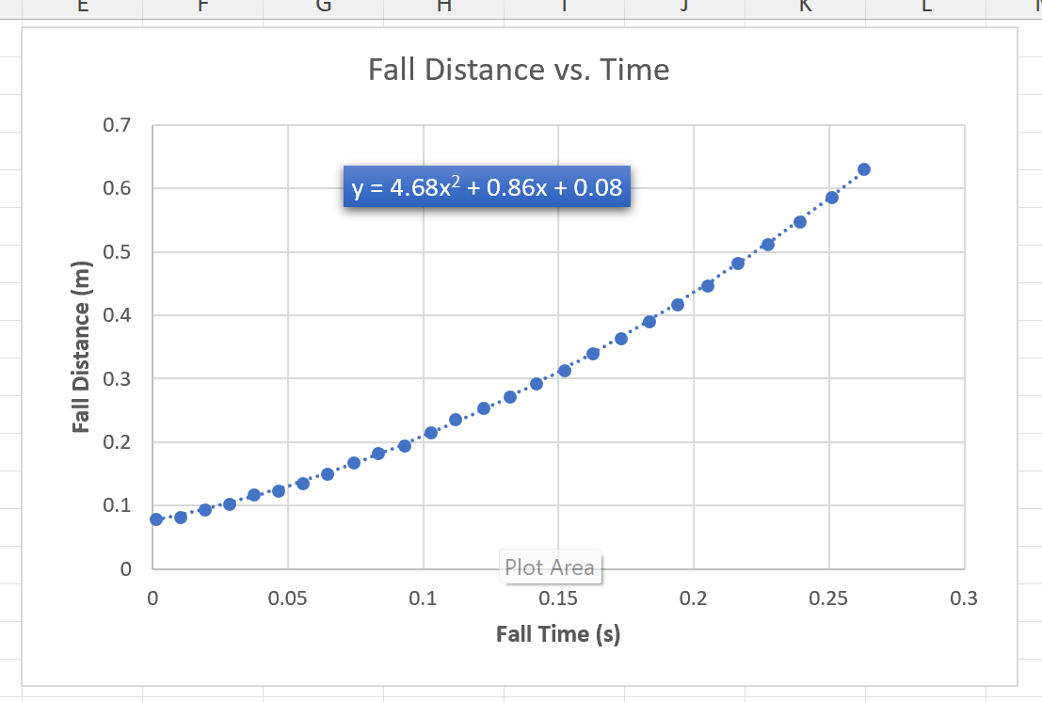
Excel Graph
(Screenshot)
Include Excel graph for a single trial showing the fall distance as a function of time.
Confirm that most data points fall along the curve fitting.
The x² coefficient should be between 2.5 and 7.5 such that its yields an acceleration value between 5 m/s² and 15 m/s²

Slide 18
Data Collection
Trial | x² coefficient value from curve fitting | Acceleration (m/s²) = 2* (x² coefficient)
1 | 4.68 | 9.36m/s^2
2 | 5.02 | 10.04m/s^2
3 | 4.66 | 9.32m/s^2
4 | 4.62 | 9.24m/s^2
5 | 4.73 | 9.46m/s^2

Slide 19

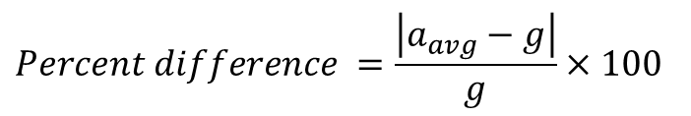
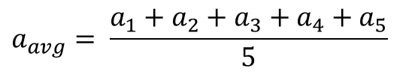
Data Analysis
Average acceleration from table
Percent difference with $g=9.8 m/s^{2}$
$$a_{avg}= \frac{a_{1}+a_{2}+a_{3}+a_{4}+a_{5}}{5}$$
9.48
m/s^2
$$Percent difference =\frac{\left|a_{avg}−g\right|}{g}×100$$
3.27
%

Slide 20
Conclusions
Briefly describe and explain the results.
  Answer: We observed the variation of the fall of an object from the force of gravity and the exterior forces such as air resistance and innacuracies in the measuring device.
How much variation is there from trial to trial? What does this indicate about the uncertainty of the result?
  Answer: All of the trials feel within .5 of each other showing the results are consistent and can lead you to develop a fair opinion from the results of the test.

Slide 21
Conservation of Energy of a Free-Falling Object

Slide 22
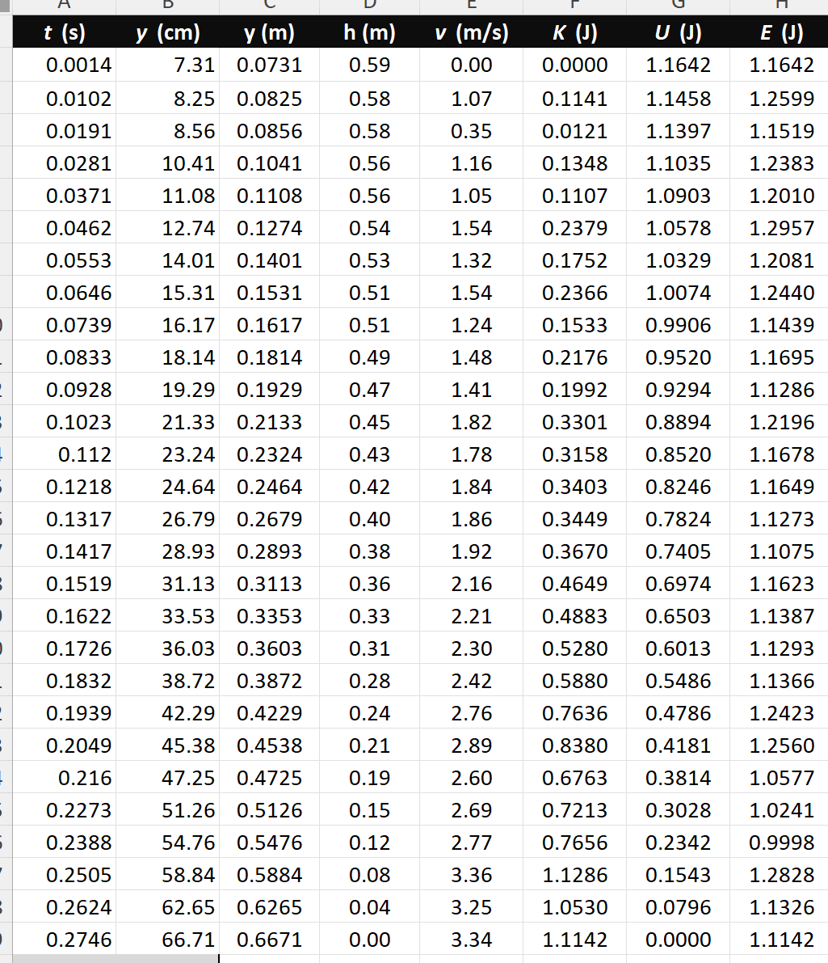
Excel Table
(Screenshot)
Include all values in the Excel table for a single trial showing the fall distance in centimeters and meters as a function of time with the values generated for kinetic energy K, potential energy U, and total mechanical energy E.

Slide 23
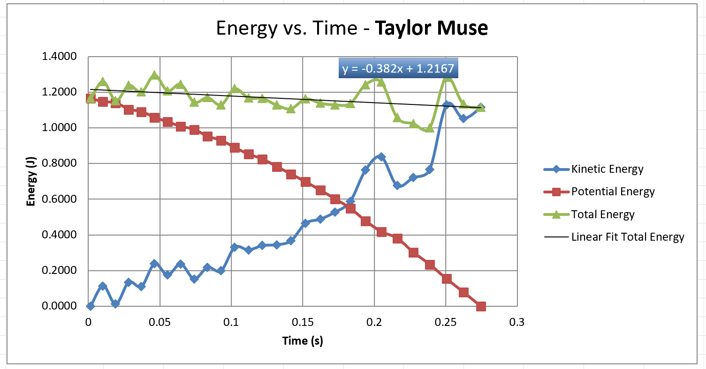
Excel Graph
(Screenshot)
Include Excel graph for a single trial showing the plots of the kinetic energy K, potential energy U, and total mechanical energy E as a function of time.
Must include your name in the title of the graph.

Slide 24

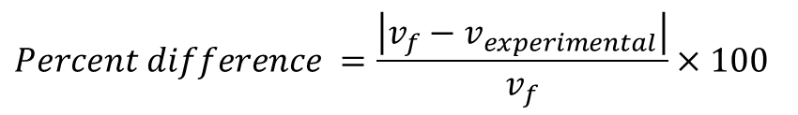


Data Analysis
Theoretical value of final velocity
Final velocity from experimental data (or largest velocity)
Percent difference
$h=y_{final}−y_{initial}=$
0.594
m/s
$v_{f}=\sqrt{2gh}=$
3.41
m/s
$v_{experimental}$ =
3.34
m/s
$$Percent difference =\frac{\left|v_{f}−v_{experimental}\right|}{v_{f}}×100$$
2.05
%

Slide 25
Conclusions
Discuss the key characteristics of the plot. Consider the points when potential energy U is maximum, U is minimum, kinetic energy K is maximum, K is minimum and when U and K are the same value. What is the significance of these points?
  Answer: The potential energy is at its maximum is the first point gathered in the test, the minimum is the last point gathered. So as the object starts falling the potential energy is the greatest until it stops falling. As the kenetic energy reaches its maximum just before impact and acts inversely as the potential energy as the object falls the potential energy is transferred to kinetic. This relationship is better understood as the transfer of energy and shows that as the kinetic energy increases the potential energy decreases because it has been transferred already.

Slide 26
Conclusions
What is the trend of the best fit line for the total energy E in your data? If the data is accurate, the total mechanical energy should decrease slightly. Why is that?
  Answer:
  The best line of fit roughly stays the same representing that the total energy stays the same throughout the entire test because the law of conservation of energy states that energy can not be added or removed only transferred. The total mechanical energy will decrease over time due to the outward forced of air resistance or drag on the object.

Slide 27
Relationship between Linear and Rotational Motion

Slide 28
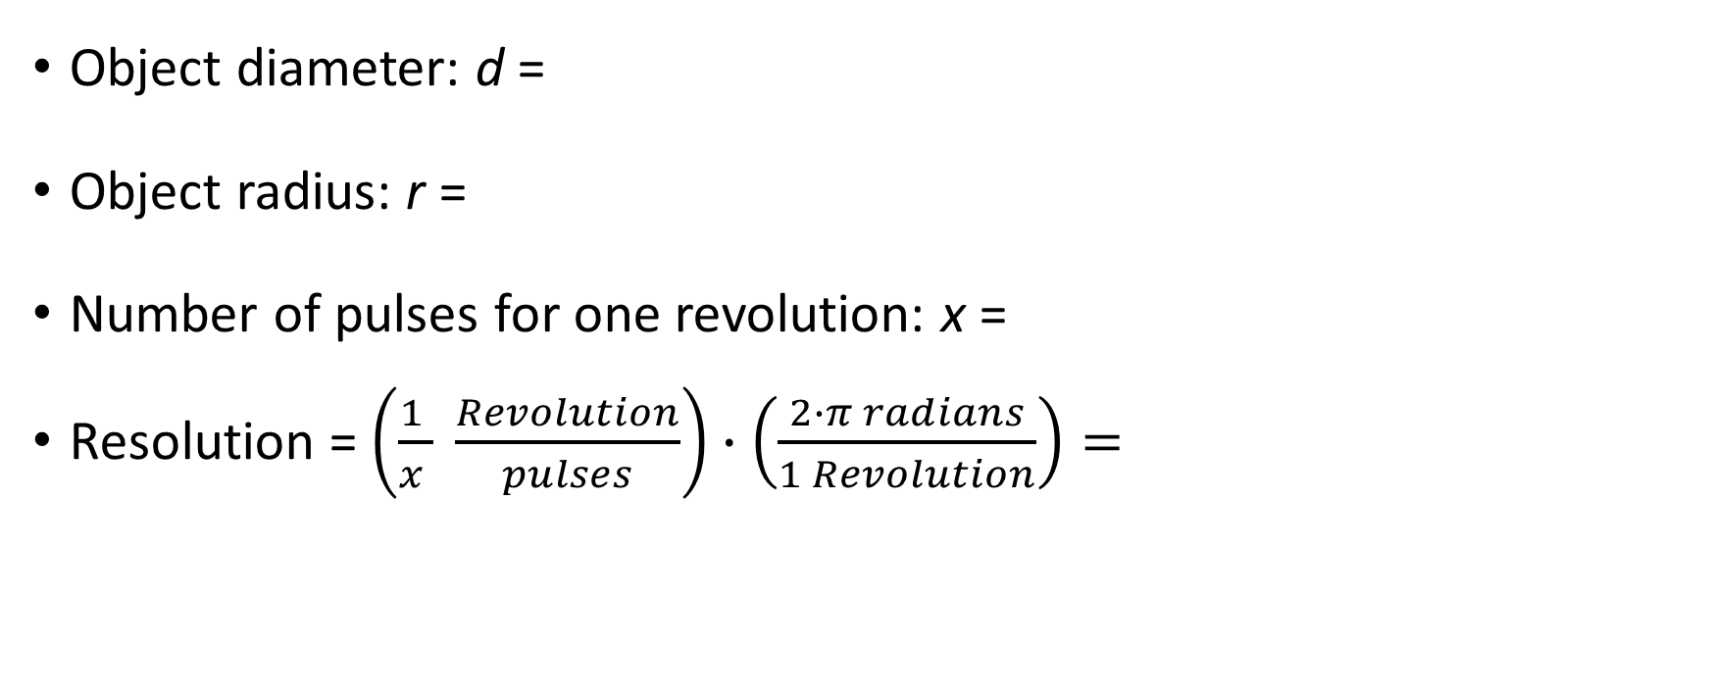
Data Collection
Object diameter: d =
Object radius: r =
Number of pulses for one revolution: x =
Resolution = $\left(\frac{1 }{x } \frac{Revolution}{pulses}\right)∙\left(\frac{2∙π radians}{1 Revolution}\right)=$
7
cm
3.5
cm
40
.157
Radians/pulse

Slide 29
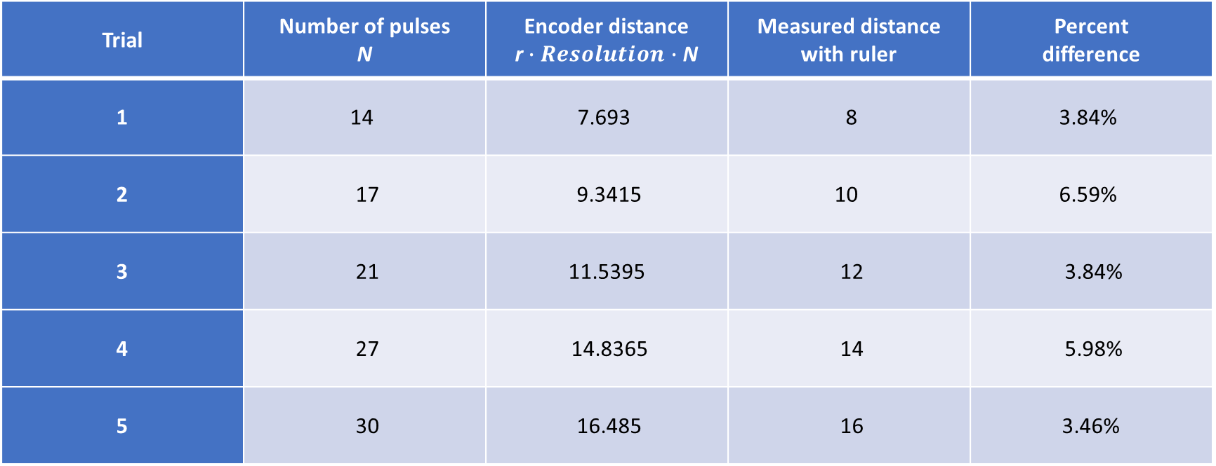
Data Analysis
Trial | Number of pulses N | Encoder distance r$∙Resolution∙$ N | Measured distance with ruler | Percent difference
1 | 14 | 7.693 | 8 | 3.84%
2 | 17 | 9.3415 | 10 | 6.59%
3 | 21 | 11.5395 | 12 | 3.84%
4 | 27 | 14.8365 | 14 | 5.98%
5 | 30 | 16.485 | 16 | 3.46%

Slide 30
Conclusions
Briefly describe and explain the results.
  Answer: in this test we determined how well this encoder is able to detect the smallest movement on the encoder. As seen in the difference between the encoder measurement and the actual distance travelled by the object is less than 7%
What are some applications of this measuring technique? Could this measuring system be used to measure surfaces that are not flat?
  Answer: This measuring device could be used in automobiles for traction control or stability control to ensure that all tires are moving at the same speed and to control the braking or individual power to each wheel. It can be used to on surfaces that are not flat, if an object is round you would only need to know the radius of the object being measured to calculate the distance measured.

Slide 31
Observing the Hall Effect

Slide 32
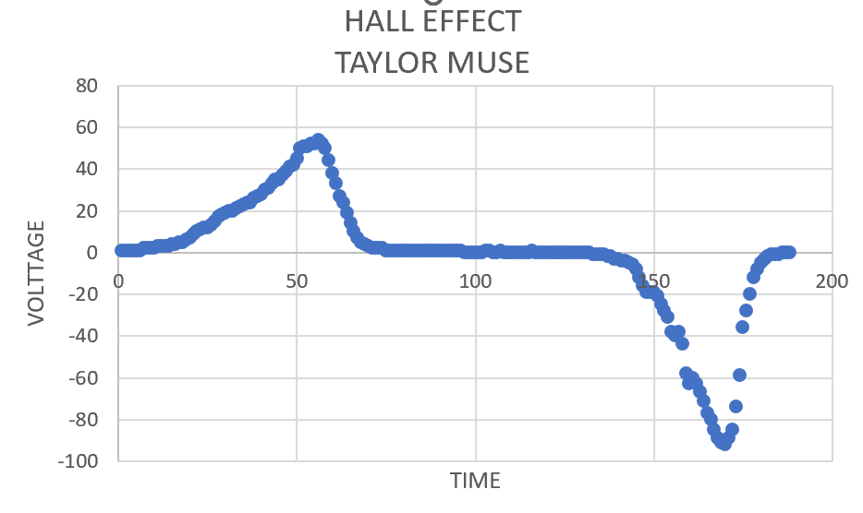
Excel Graph
(Screenshot)
Include Excel graph for a single trial of data plotted as a function of time.
Must include your name in the title of the graph.

Slide 33
Conclusions
Briefly describe and explain the results.
  Answer: A hall effect sensor will convert magnetic field readings to a voltage reading, the first peak indicates a positive magnetic field followed by no magnetic field present and the second low peak indicates a negative magnetic field.
Describe how the Hall sensor works. What are some applications for the Hall effect sensor?
  Answer: a hall sensor is a transducer that converts an increasing or decreasing magnetic field into proportional voltage by forcing electrons to move to one side of the material which creates the voltage difference. This type of sensor is commonly found in proximity detection systems and automotive applications such as crankshaft position sensors, and wheel speed sensors.

Slide 34
Challenges
  Calculating the various formulas
  Formatting excel to create the graphs properly

Slide 35
Career skills
  Deeper understanding of the purpose behind the IoT sensors
  Relating the effects of the accuracy and precision of different sensors to a practical application

Slide 36

THANK YOU
Taylor Muse
https://taylormuse03.wixsite.com/my-site-7

